Slide 1



ASHRAE Handbook Chapter Revisions
Accessing & Using the
ASHRAE Authoring Portal

Slide 2
Editing Your Chapter
Revisions MUST Be Made in ASHRAE Authoring Portal
Sharepoint File
Check on Possible Restrictions
May Need to Use Personal Computer
Should Work on Any OS and Browser

Slide 3
Your TC Handbook Chair Must Request Access
If Problems, Contact:
Moli (Heather) Kennedy
Handbook Editor
hkennedy@ashrae.org
Jeri Alger
Managing Editor
jalger@ashrae.org

Slide 4
Accessing ASHRAE Authoring Portal
Revisor Receives Email Similar to One of These:
“Kennedy, Heather is inviting you to collaborate on ASHRAE Authoring Portal”
Be Sure to Check Spam, Junk, Google Sub-Folders, etc.
Revisors Confirm Access to Your Handbook Chair !!

Slide 5
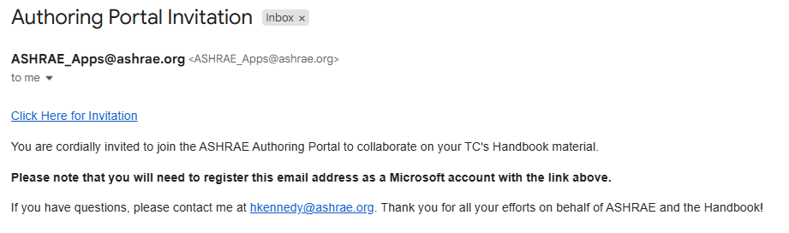
Accessing ASHRAE Authoring Portal
CLICK HERE

Slide 6
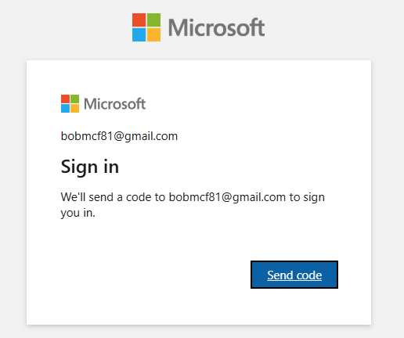
Microsoft Sign-in / Registration Required
jack.sprat12@snailmail.com
jack.sprat12@snailmail.com
to sign you in.
CLICK HERE TO REQUEST CODE

Slide 7
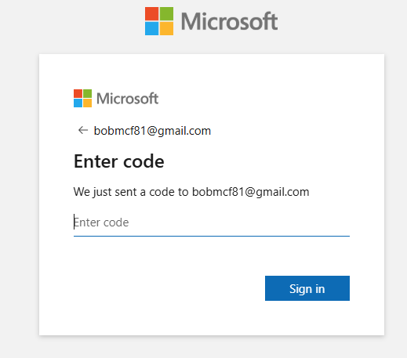
Microsoft Sign-in / Registration Required
jack.sprat12@snailmail.com
ENTER CODE SENT TO THIS EMAIL ADDRESS
jack.sprat12@snailmail.com
123456
CLICK TO SIGN-IN

Slide 8
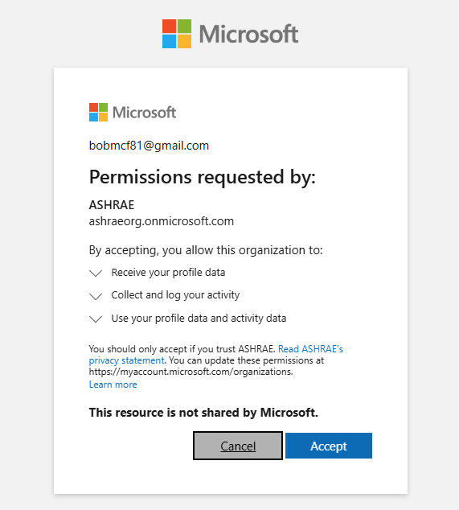
Microsoft Sign-in / Registration Required
jack.sprat12@snailmail.com
CLICK TO ACCEPT CONDITIONS

Slide 9
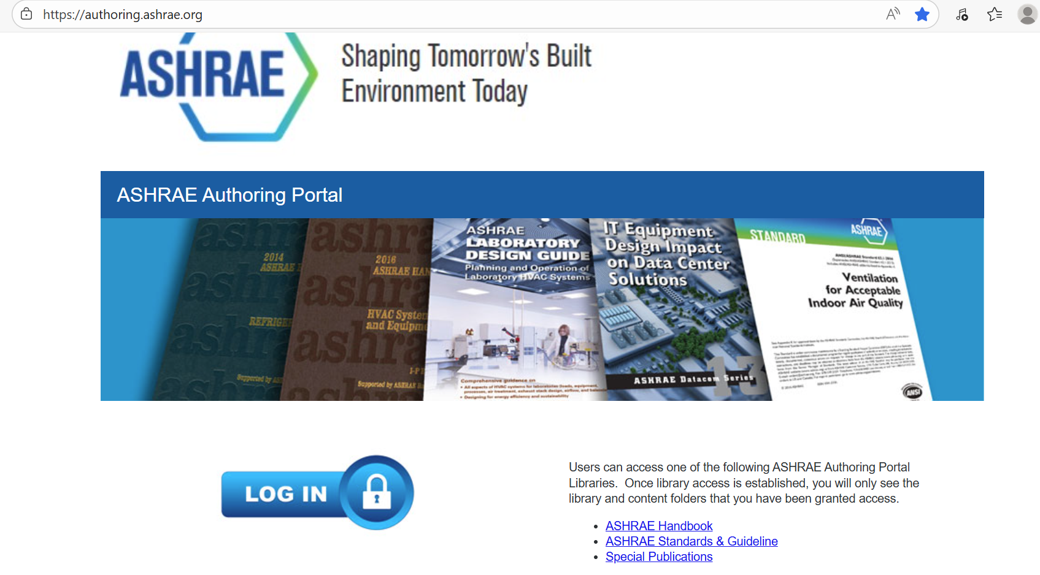
Receive Authoring Portal Access
LOG-IN WITH MICROSOFT PASSWORD
(Create Account if Necessary

Slide 10
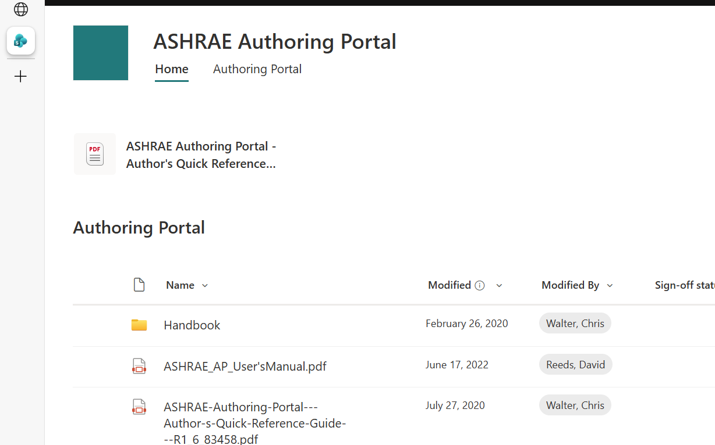
Accessing Your Chapter
Click on “Handbook”
Read Other Documents !”
CLICK HERE TO FIND YOUR CHAPTER
THESE ARE ALSO VERY IMPORTANT !!

Slide 11
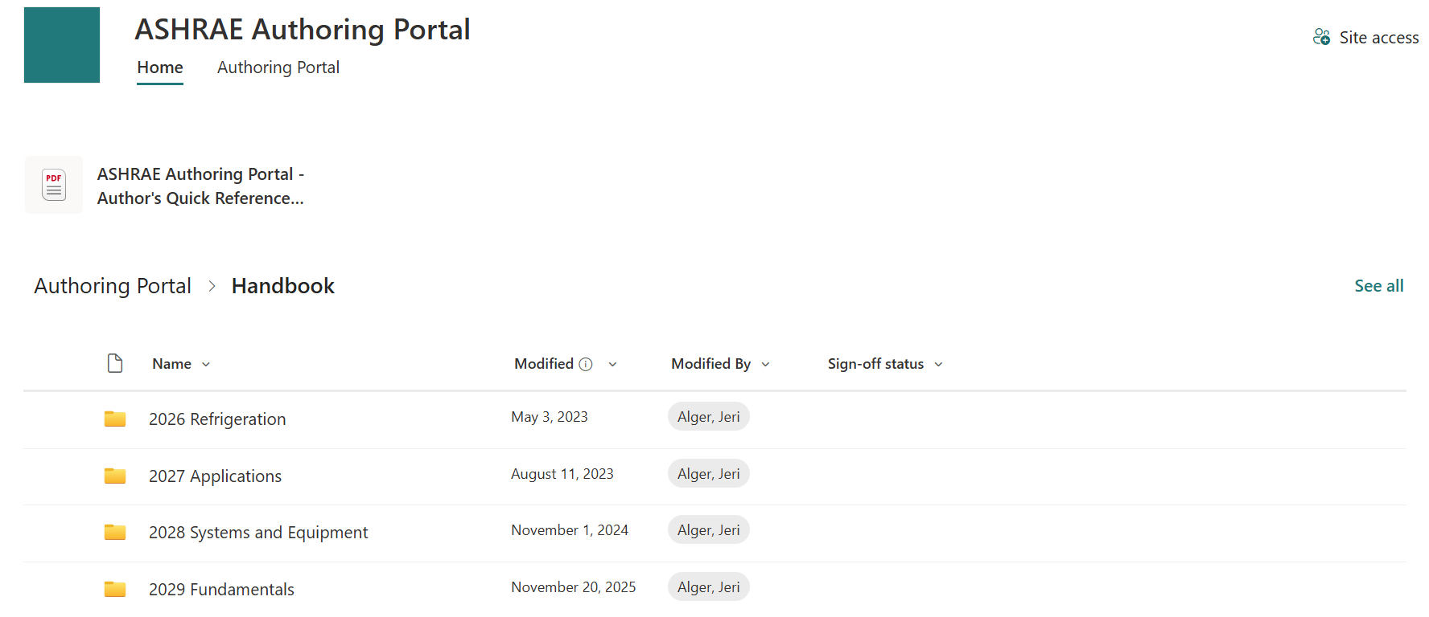
Accessing Your Chapter
YOU MAY SEE ONLY ONE OR ALL OF THESE.
CLICK ON YOUR VOLUME

Slide 12
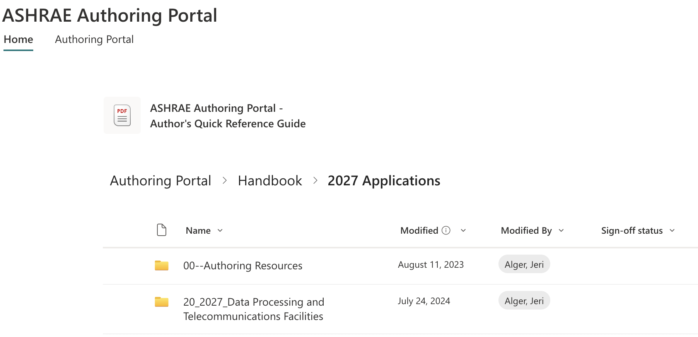
Accessing Your Chapter
YOU MAY SEE JUST YOUR CHAPTER
Additional help docs here!
Click on Your Chapter File Folder

Slide 13
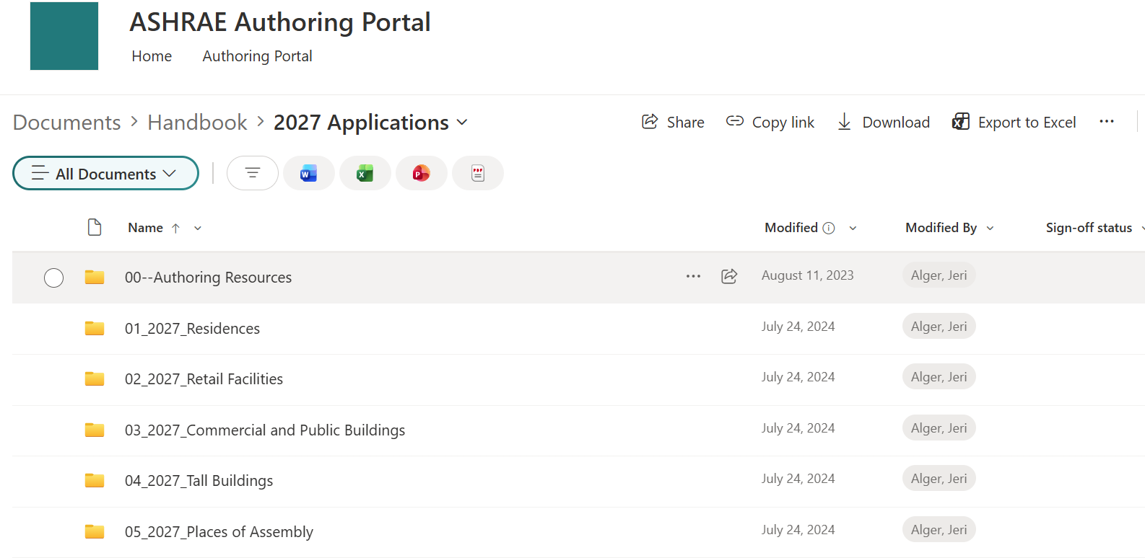
Accessing Your Chapter
OR YOU MAY SEE ALL CHAPTERS IN VOLUME
Click on Your Chapter File Folder

Slide 14
Editing Your Chapter
AUTHORING PORTAL CONTAINS:
Your Chapter from Last Published Handbook
    Both I-P and SI in Same File
MS “Word” Translation from “Framemaker”
  NOT a Formatted File
PDF Version
  Formatted File, but Harder to Work On
User’s Manual
Quick Reference Guide

Slide 15
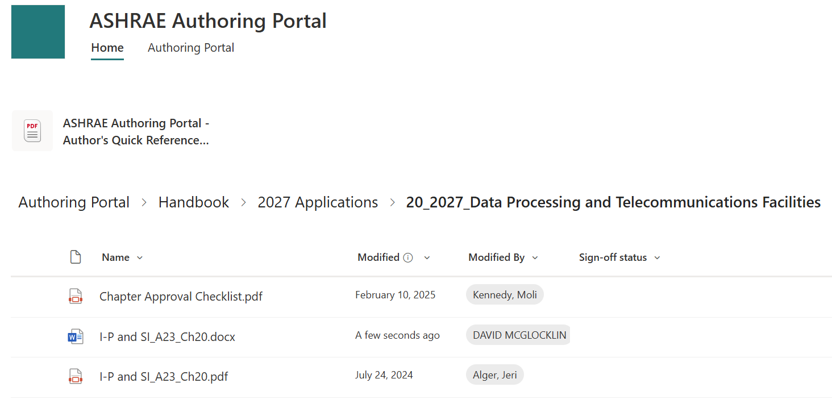
Accessing Your Chapter
This is the MS “Word” Document

Slide 16
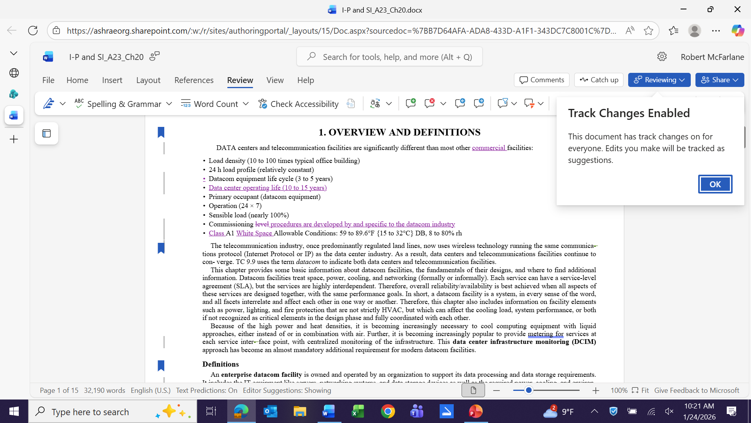
Editing Your Chapter
Must Use Track Changes for Word Docs

Slide 17
Editing Your Chapter
VERY IMPORTANT !!
All “Word” Revisions Must Be Made With “Track Changes”
Do NOT Turn Off !!!
Do NOT “Accept Changes” !!!
However, You CAN Make Document More Readable

Slide 18
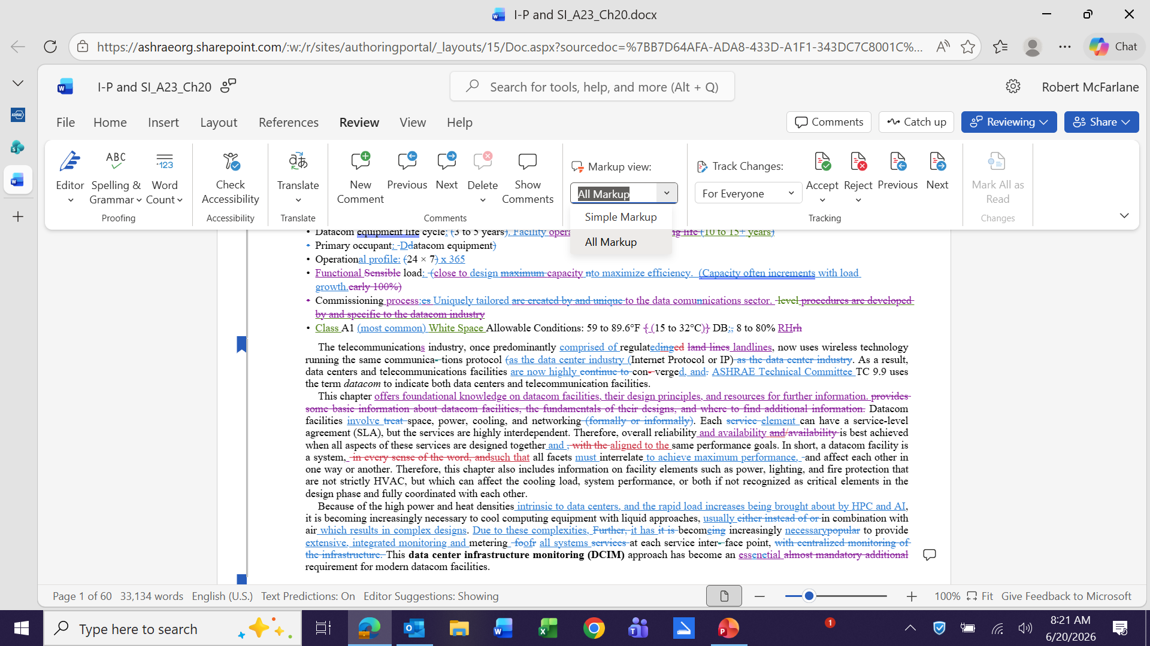
Editing Your Chapter
Can Toggle
Btw’n. “All” and “Simple” Markup by Clicking Bar

Slide 19
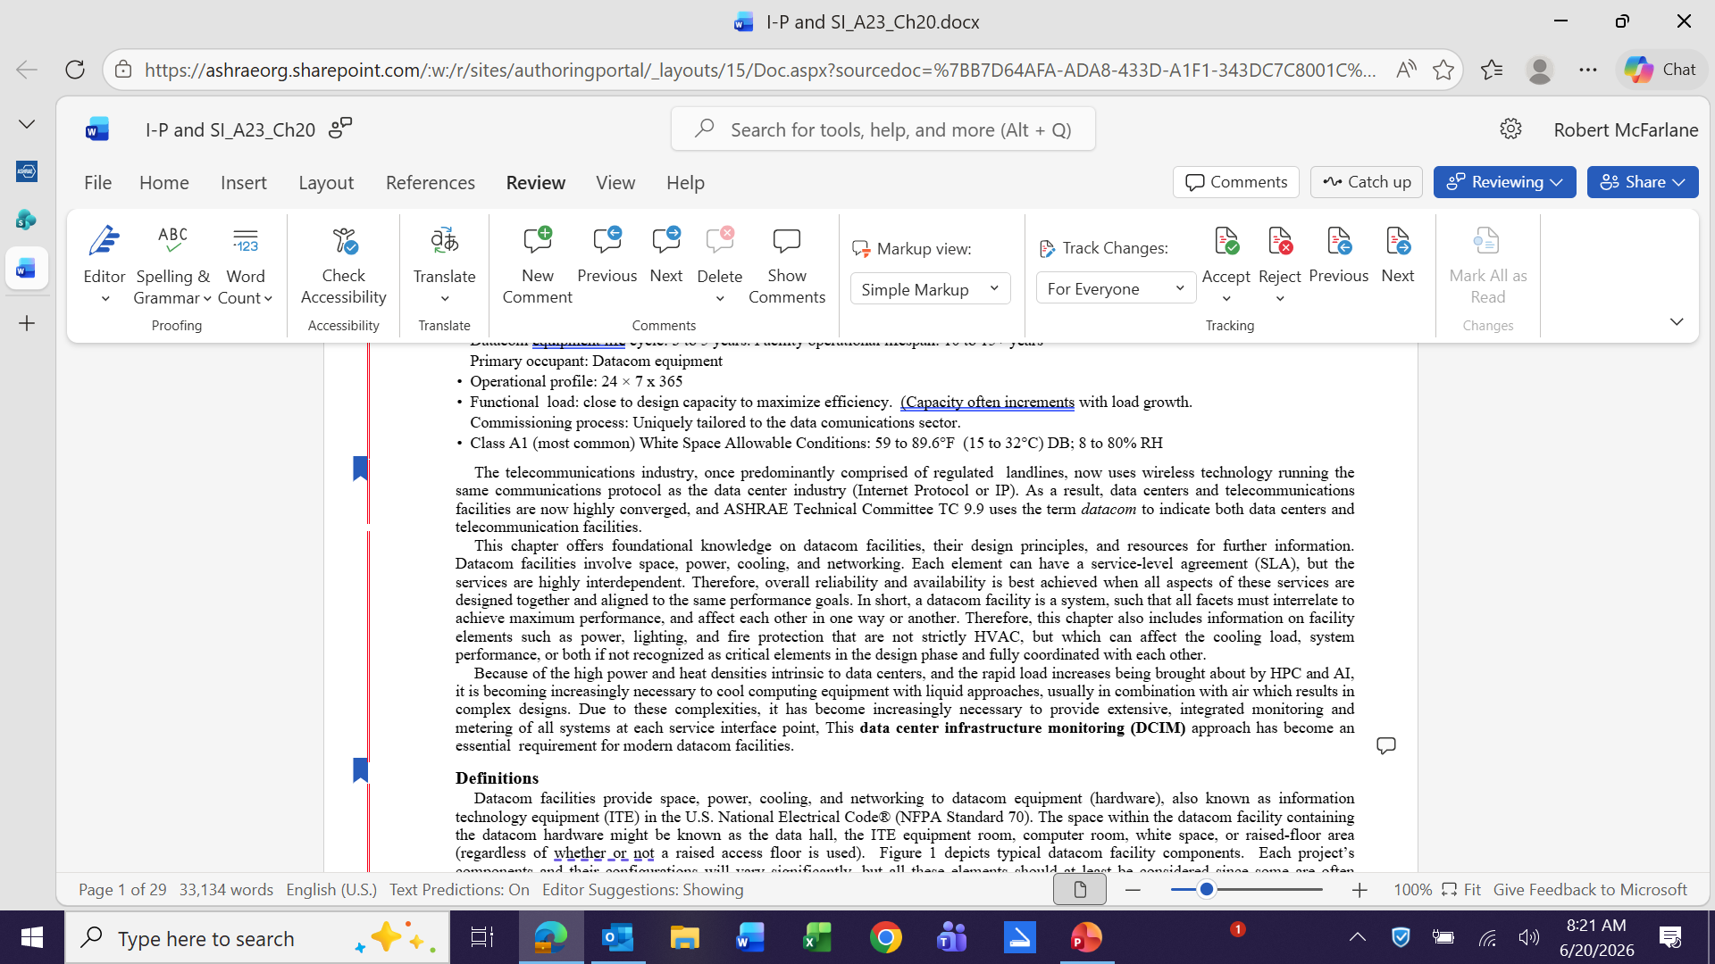
Editing Your Chapter
Click “Review”
“Track Changes”
Still Works
Only Comments Still Show

Slide 20
Editing Your Chapter
WHO CAN SEE REVISIONS?
Everyone with Authoring Portal Access
People Can Work Simultaneously
Will Not See Other Revisions Until Saved
Can See Who Revised by Color & Clicking
Need to Edit ONLY One Document
Include BOTH I-P & SI Nomenclatures

Slide 21
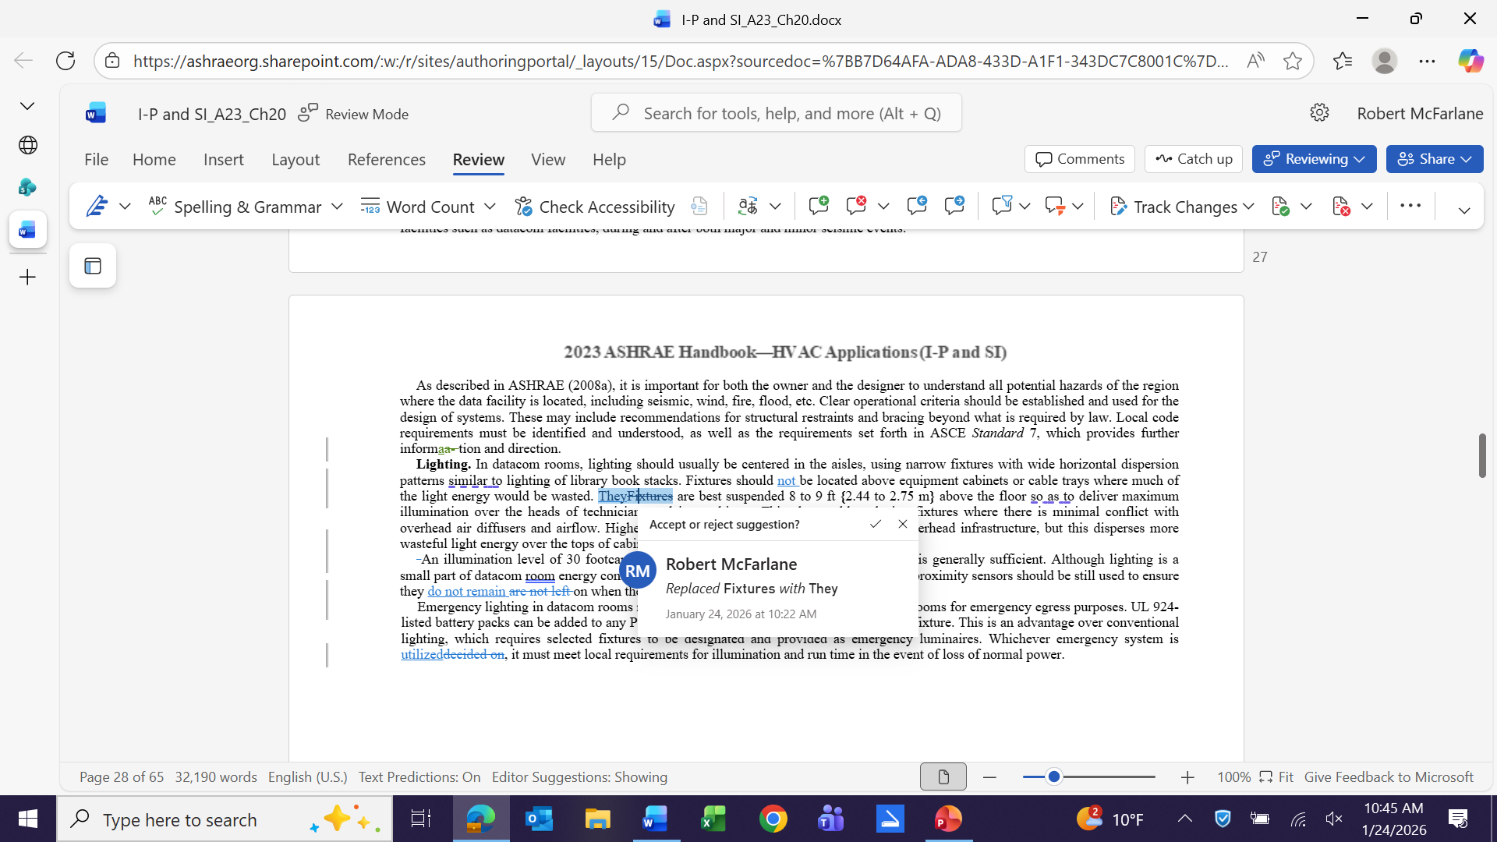
Editing Your Chapter
Colors Identify Change Authors
Click to See Who

Slide 22
Editing Your Chapter
This is the PDF Document

Slide 23
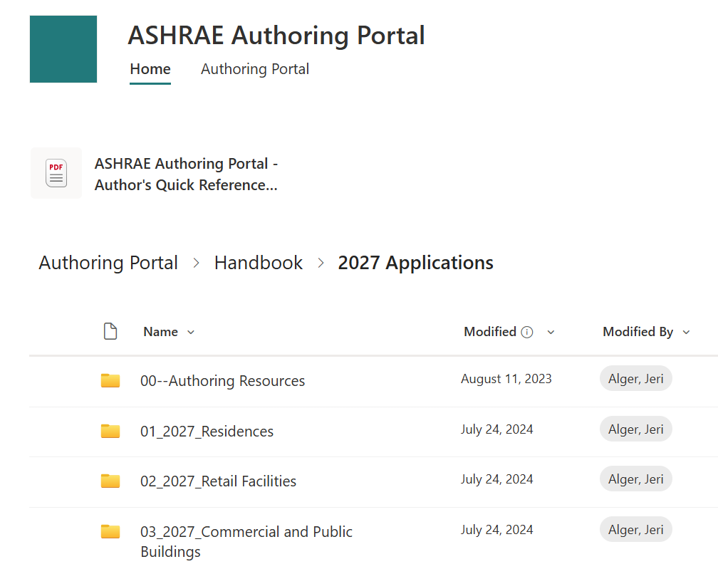
Editing Your Chapter
If Revising a PDF
Go To
“00-Authoring Resources”

Slide 24
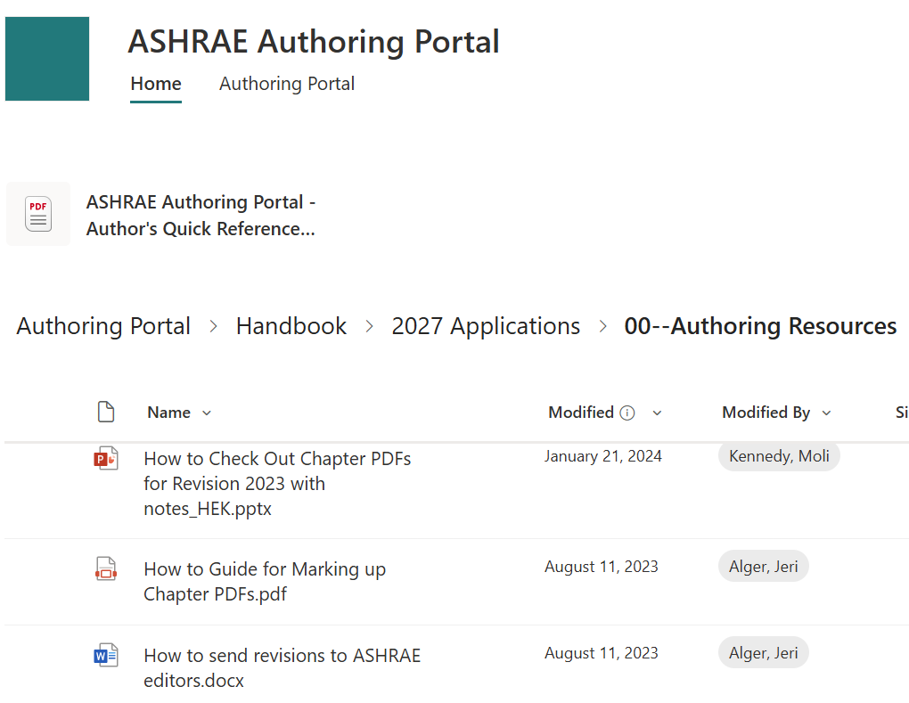
Editing Your Chapter
Read
“How to Guide for
Marking-up
Chapter PDF’s”
Must Use
Adobe Annotation Tool”

Slide 25
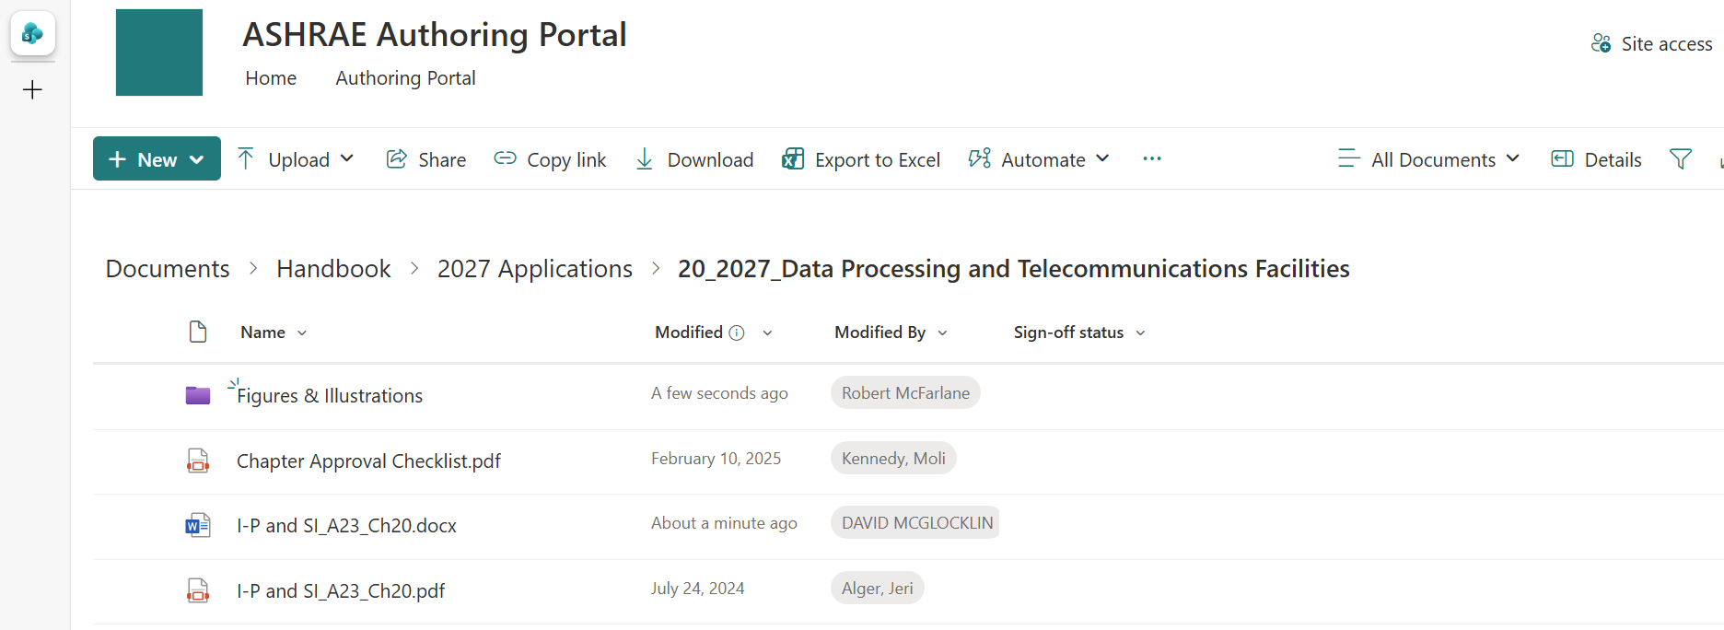
Editing Your Chapter
If You Don’t Have a Folder for Illustrations
Your Handbook Chair Should Create One
Store New and Revised Charts and Illustrations Here
Reference in Word Document

Slide 26
Editing Your Chapter
Select Colors That Reproduce in B & W
Must Have Permissions
If From ASHRAE Publication – Cite Source
If From US Gov’t. Publication – Cite Source
If From Company
Written Permission Letter
Preferably “In Perpetuity”
If Original Creation, ASHRAE is Granted Copyright. (Creator Listed on Contributors Page)

Slide 27
Figures & Illustrations
Format Preferences:
1. Layered PSDs (PhotoShop Documents)
2. Flattened TIFFs
3. Flattened JPEGs.
600 DPI or Greater
(Internet Copies are NOT Usable!)
Large Tables or Examples
Upload Excel Files or Table – Note in Text

Slide 28
Figures & Illustrations
ANNOTATE IN TEXT !!
Insert “Comment”
  Indicate “New” or “Replaced”
  If Simple Revision, Explain

Slide 29
ASHRAE Handbook Chapter Revisions
Now You Can Get to Work
Make Sure You Know Your Due Dates !!

