Slide 1


ASHRAE Handbook Training
for
TC Handbook Chapter Chairs
Moli (Heather) Kennedy
Handbook Editor
hkennedy@ashrae.org
Jeri Alger
Managing Editor
jalger@ashrae.org

Slide 2


AGENDA
“Pep Talk – Why You Are SO Important!”
Handbook Facts & Purposes
Handbook Revision Process
The “Authoring Portal”

Slide 3

WHY DID WE WANT YOU HERE?
YOU
Are the Front Line
for
ASHRAE’s Most Important Publication

Slide 4

Chapters are Also TCs’ Public Face
Put Your Best Foot Forward!!
The Quality of Your Chapter
Reflects the Quality of Your TC!

Slide 5

TC HANDBOOK CHAIRS
It’s a Team Effort!!
You Are Critical
for
Maintaining Schedule
Ensuring Quality
Updating Your Handbook Liaison

Slide 6
YOU HAVE LOTS OF BACKUP
Handbook Committee Is Responsible for:
Formulating Editorial Policies
Responding to Questions & Comments Re: Content & Procedures
Assigning Chapters to Appropriate TCs

Slide 7











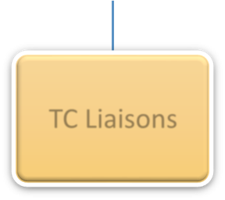
YOU HAVE LOTS OF BACKUP
Handbook Committee
Review/ Training
Electronic Media
Strategic Planning
Volume
Executive
Functional
TC Liaisons
Make Sure You Know Your Liaison!
TC CHAIR

Slide 8

YOU HAVE LOTS OF BACKUP
Your Handbook Liaison Is Responsible for:
Communicating !
Making Sure YOU Know Your Schedule
Keeping YOU On-Track
Ensuring YOU Have What YOU Need
Advising Handbook Committee of Progress

Slide 9
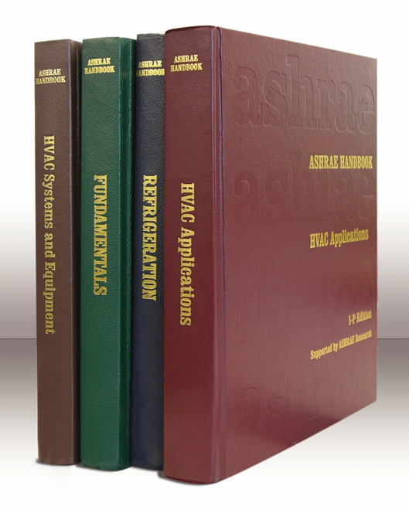

HANDBOOK FACTS
4 Volumes
One Volume Published
Every 4 Years
Both I-P and SI Versions

Slide 10
HANDBOOK PURPOSES
Manual for New Engineers
Reference for All Engineers
Alert to Needed Expertise
Best Practices Information
Legal Reference (Print Version)

Slide 11
HANDBOOK PURPOSES
ALSO
It’s ASHRAE’s Most Important Product
It’s the Worldwide “Face” of ASHRAE
It’s a Unique Product
It’s a Prime ASHRAE Member Benefit
Handbook Online, PDF, or Print
It’s the Basis for ASHRAE Codes & Standards

Slide 12
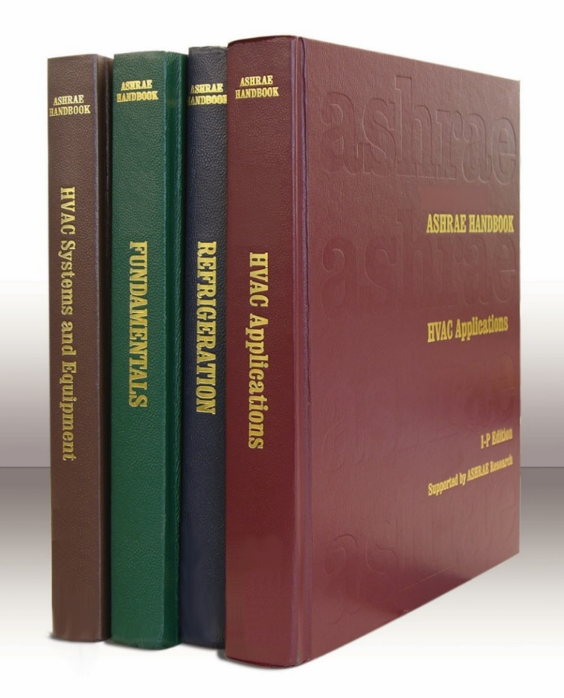
LAST PUBLICATION DATES
Refrigeration: 2022
HVAC Applications: 2023
HVAC Systems & Equipment: 2024
Fundamentals: 2025

Slide 13
NEXT PUBLICATION DATES
Refrigeration: 2026
HVAC Applications: 2027
HVAC Systems & Equipment: 2028
Fundamentals: 2029
But That’s NOT What’s Important !!

Slide 14
REVISION DUE DATES
HVAC Applications: 2026
HVAC Systems & Equipment: 2027
Fundamentals: 2028
Refrigeration: 2029
One Year Ahead of Publication Date

Slide 15
SUBMISSION DEADLINES
Some Chapters Will Move, to Reduce Size of
“Applications”
and Balance Other Volumes
(Some Opportunities for Longer Revision Times)
Your Liaison Will Advise

Slide 16
UPDATE PROCESS
PUBLISH
REVISE & UPDATE
SUBMIT
PROOF GALLEYS
PUBLISH
YR. 0
YR. 1
YR. 2
YR. 3
YR. 3.5
YR. 4
YOU REALLY HAVE ONLY 3 YEARS FROM YOUR LAST PUBLISHED VOLUME

Slide 17
UPDATE MILESTONES
6 Months: Select Reviewers
1 Year Advise Expected Revision Extent
2 Years Reviews / Rewrites
3 Years TC Review / Approval / Submit
3.5 Years Proofread Galleys
4 Years START ALL OVER AGAIN !!

Slide 18
REPORTS TO LIAISON
1 Year Advise Extent of Revisions
1.5 Years Progress
2 Years Revision Status
3 Years Confirm Submission
3.5 Years Confirm Galley Proof-Read

Slide 19
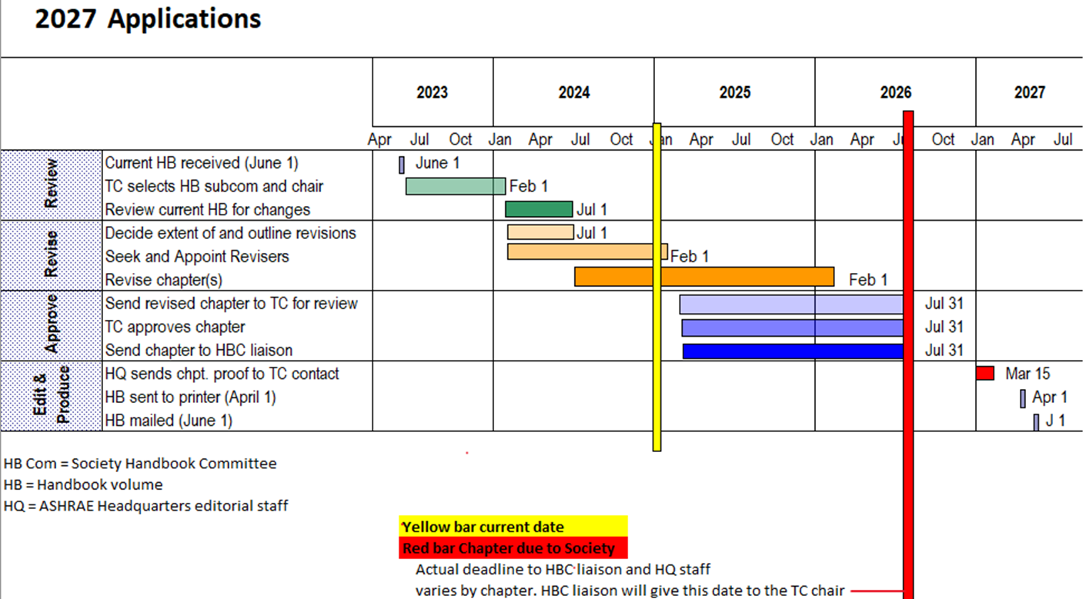
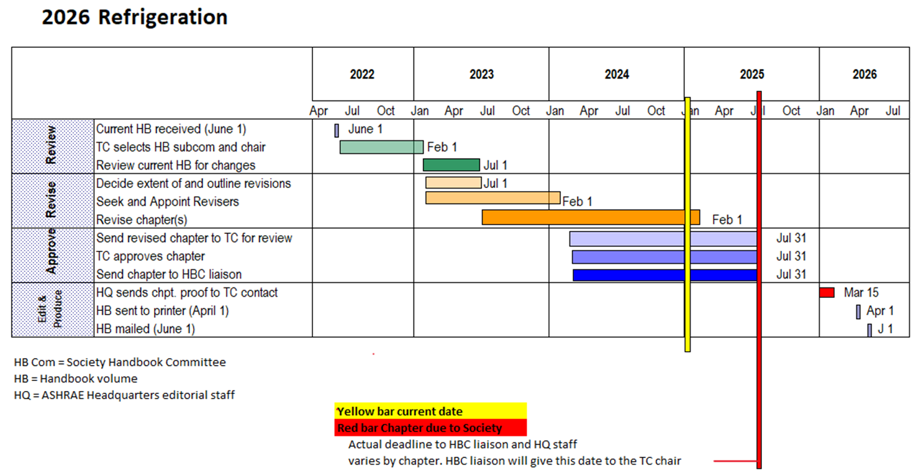
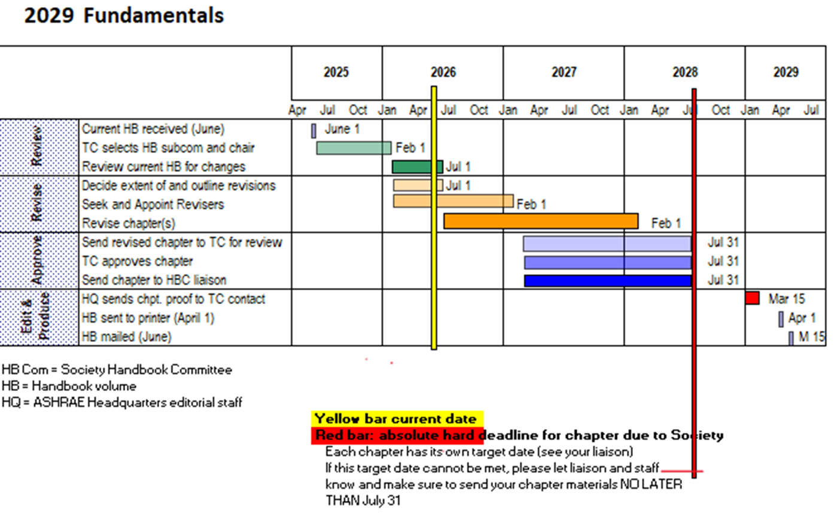
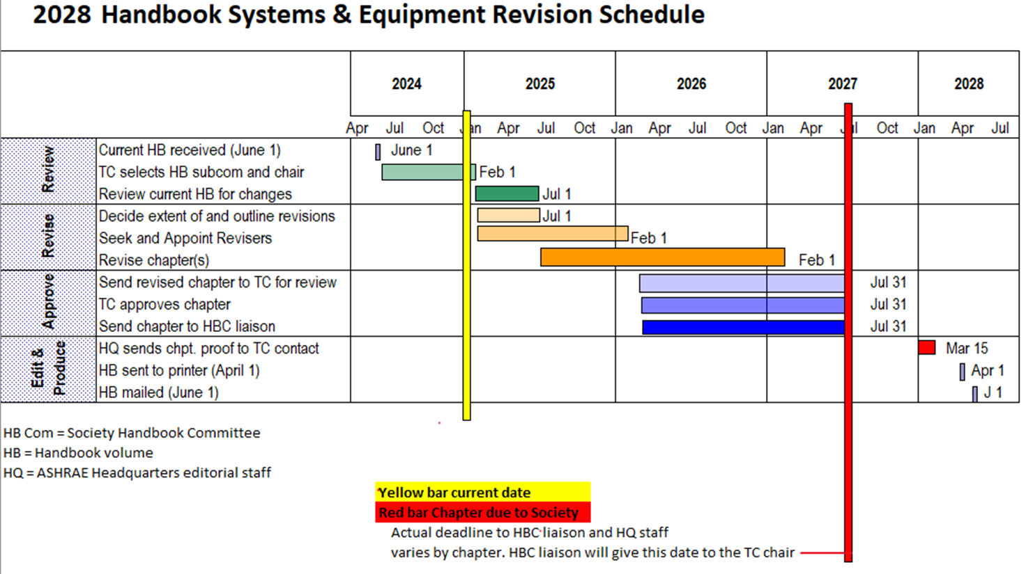
UPDATE PROCESS
MAKE SURE YOU HAVE THESE HANDOUTS

Slide 20
UPDATE PROCESS
HOWEVER
You Can Update Online Anytime You Want
Process Is the Same
Updates go to Handbook On-Line
Revisions Automatically Included in Next Publication Unless Further Altered

Slide 21
UPDATE PROCESS
WHY UPDATE SOONER?
You’re in a Fast-Changing Field
Research Results Come After Submission
Technical Paper Provides New Information (Peer-Reviewed Material)
Important News Published in Press (You Want Your Chapter to Remain Relevant)

Slide 22
UPDATE PROCESS
REQUESTING A NEW CHAPTER
or
DELETING OR RE-ASSIGNING A CHAPTER
Anyone Can Submit a Request
TC, HBC Chair, HB Editor
Prepare an Outline w/ Evaluation Criteria
Justification. What Will it Add to Handbook?
Submit to Liaison & HB Editor
Assigned to TC When Reviewed & Approved

Slide 23
UPDATE PROCESS
DISPUTE RESOLUTION
DEFINITION: A major difference of opinion or fact with part or all of a chapter, that is brought to the attention of the HBC and which could affect the credibility or reputation of ASHRAE
ACTION: The HBC shall ensure that the dispute is handled professionally, fairly, and without bias.

Slide 24
UPDATE PROCESS
DISPUTE ORIGINS
Individual: Someone simply disagrees with part or all of a chapter. (Could be within the TC.)
Handbook Conflict: Something in one Handbook chapter conflicts with something in another chapter.
Conflict with Standard: Something in a Published Standard differs from a Handbook Chapter.

Slide 25
UPDATE PROCESS
ADDRESSING CONFLICTS BETWEEN HANDBOOK CHAPTERS & STANDARDS OR GUIDELINES
Responsibility:
TC Must Identify and Address Conflicts
Action Options:
Revise Chapter to Eliminate Conflict
Comment on Standard or Guideline w/ Suggested Conflict Resolution

Slide 26
RESOLUTION PROCESS
Volume SC Chair and HBC Chair
Meet with conflicting parties for resolution
If not resolved, form Handbook Resolution Committee
Volume SC Chair
Notifies HBC Chair
HB Liaison
Determines conflict occurring within a TC

Slide 27
REVISIONS
All Revisions Are Made in ASHRAE Authoring Portal
Sharepoint File Check on Possible Restrictions May Need to Use Personal Computer
Should Work on Any OS and Browser If a Problem, Contact Moli (Heather Kennedy)

Slide 28
REVISIONS
REQUEST AUTHORING PORTAL ACCESS FOR ALL INVOLVED IN CHAPTER REVISION
Handbook Chair: Emails Request to:
mkennedy@ashrae.org
Revisor Receives Email:
“Kennedy, Heather is inviting you to collaborate on ASHRAE Authoring Portal”
Revisors Confirm Access to Handbook Chair !!

Slide 29
REVISIONS
AUTHORING PORTAL CONTAINS:
Your Chapter from Last Published Handbook
Both I-P and SI in Same File
MS “Word” Translation from “Framemaker”
NOT a Formatted File
PDF Version
Formatted File, but Harder to Work On
User’s Manual
Quick Reference Guide

Slide 30
REVISIONS
WHO CAN SEE REVISIONS?
Everyone with Authoring Portal Access
People Can Work Simultaneously
Will Not See Other Revisions Until Saved
Can See Who Revised by Color & Clicking
Need to Edit ONLY One Document
Include BOTH I-P & SI Nomenclature

Slide 31
REVISIONS
VERY IMPORTANT !!
All “Word” Revisions Must Be Made With “Track Changes”
Do NOT Turn Off !!!
Do NOT “Accept Changes” !!!
All PDF Revisions Must Be Made With “Adobe Annotation Tool”

Slide 32
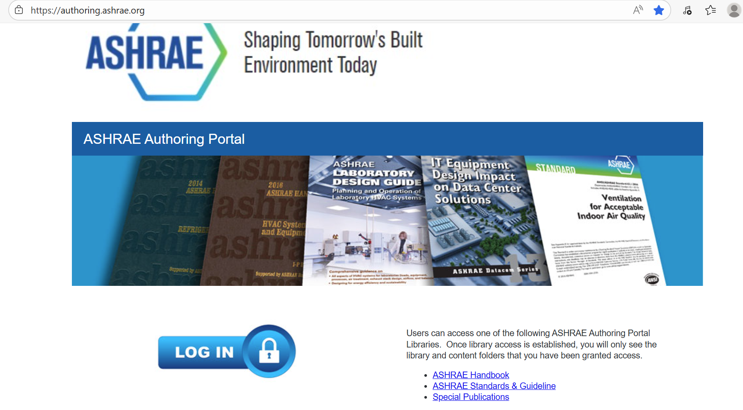
AUTHORING PORTAL

Slide 33
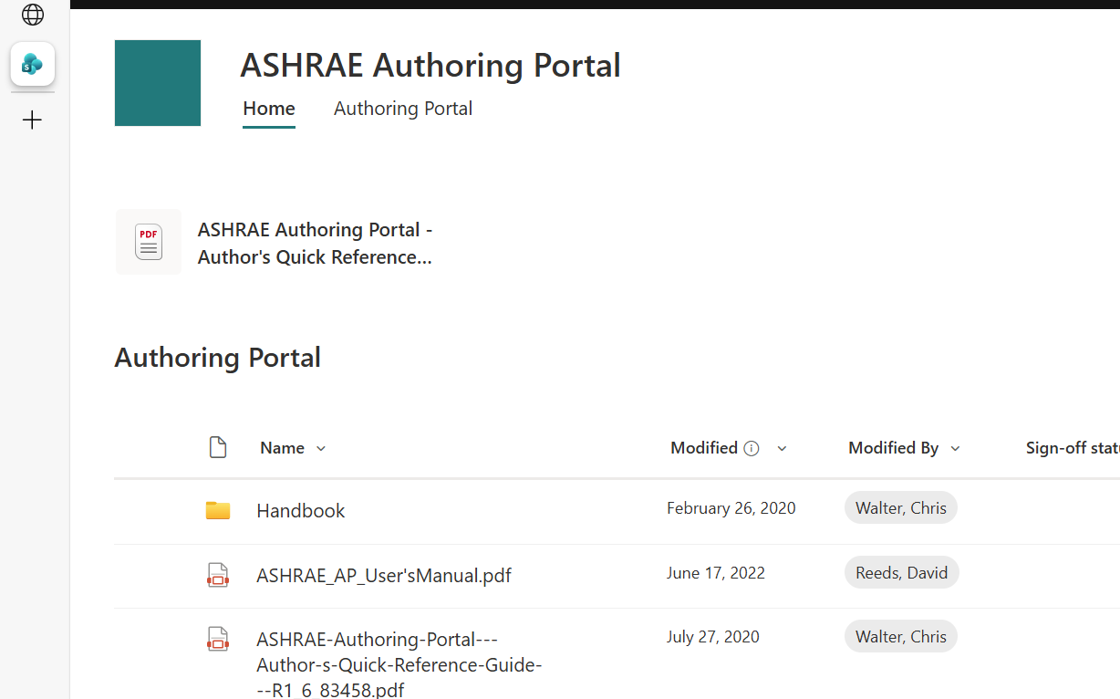
AUTHORING PORTAL
Click on “Handbook”
Read Other Documents !”
CLICK HERE TO FIND YOUR CHAPTER
THESE ARE ALSO VERY IMPORTANT !!

Slide 34
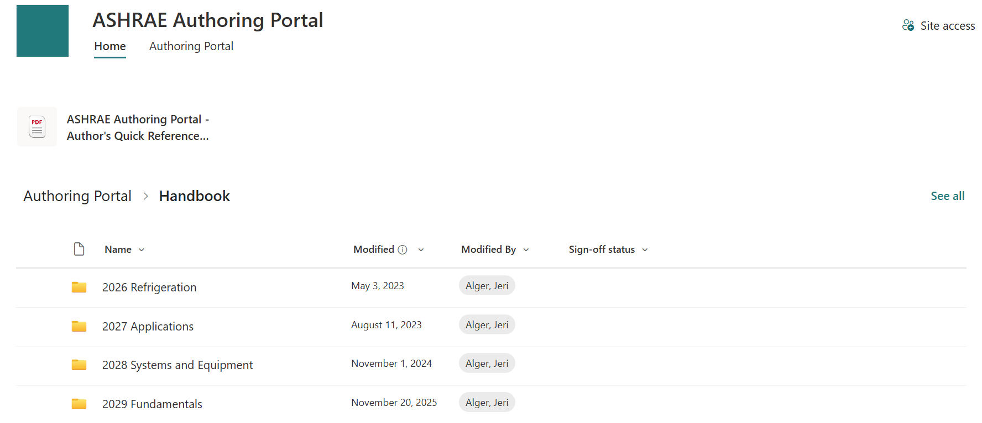
AUTHORING PORTAL
YOU MAY SEE ONLY ONE OR ALL OF THESE.
CLICK ON YOUR VOLUME

Slide 35
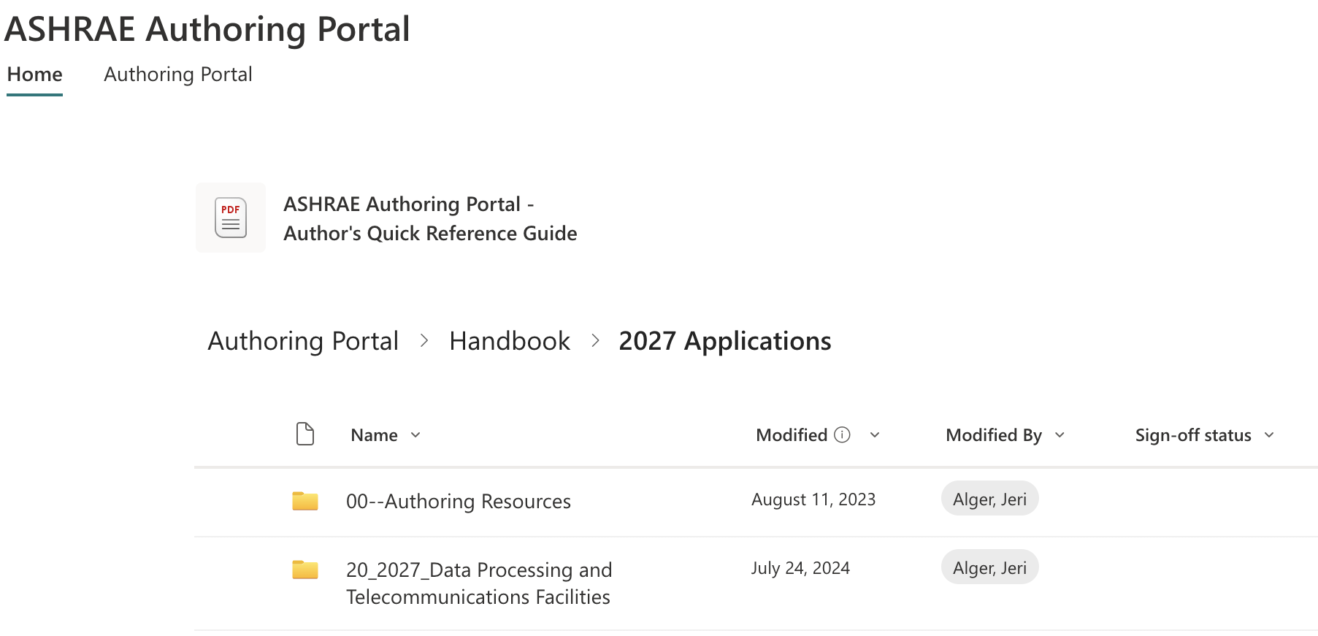
AUTHORING PORTAL
Click on Your Chapter File Folder
Additional help docs here!

Slide 36
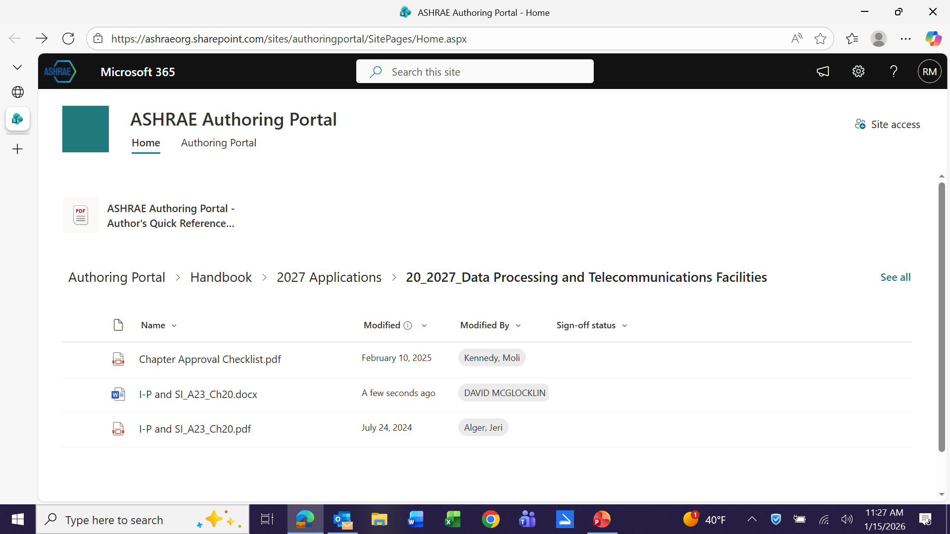
AUTHORING PORTAL
Understand the Chapter Approval Checklist!
TC Chairs
Be Sure to Look at This

Slide 37
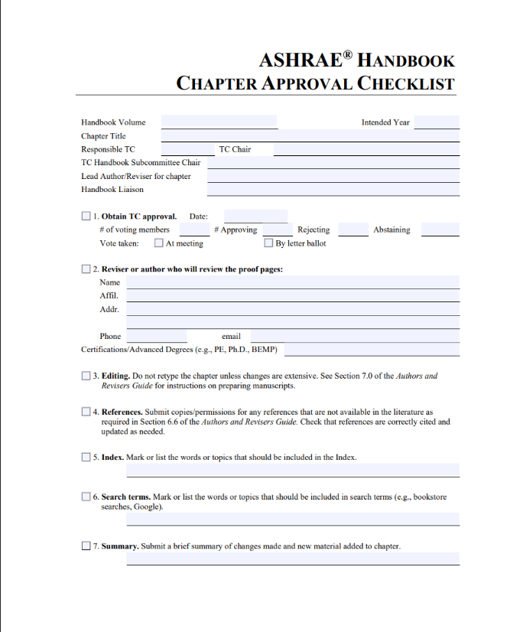
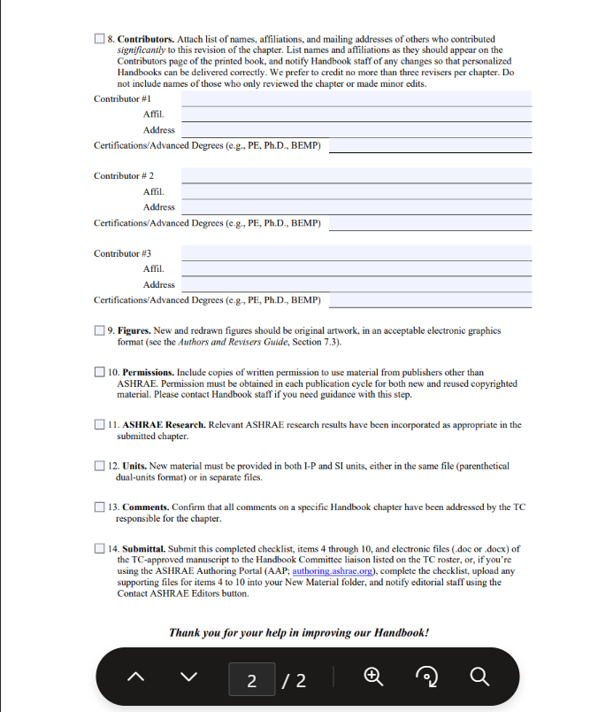
AUTHORING PORTAL

Slide 38
AUTHORING PORTAL
Major Chapter Approval Checklist Items
Your TC Board Vote
Anyone Not Voting, List as “Abstain”
Significant Contributors
If More Than 3, Include Attachment
Figures
MUST Have All Permissions!!

Slide 39
AUTHORING PORTAL
This is the MS “Word” Document
Your Chapter is a Word
and
PDF Document

Slide 40
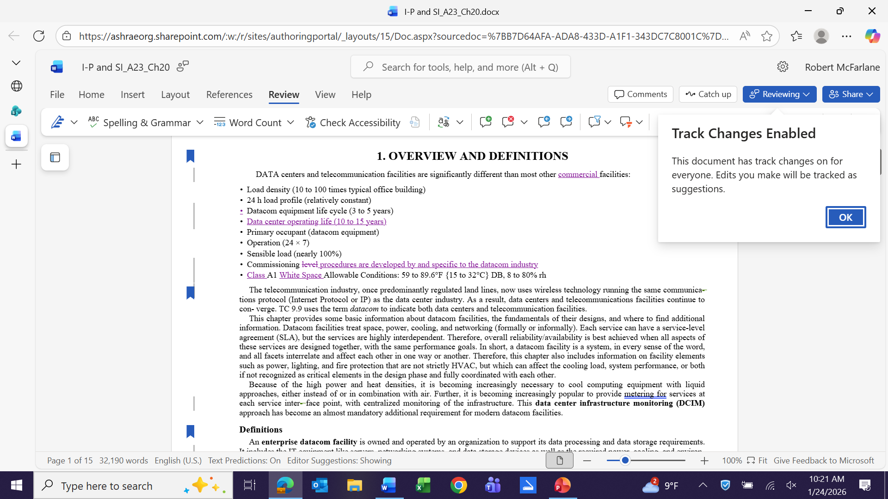
AUTHORING PORTAL
Must Use Track Changes for Word Docs

Slide 41
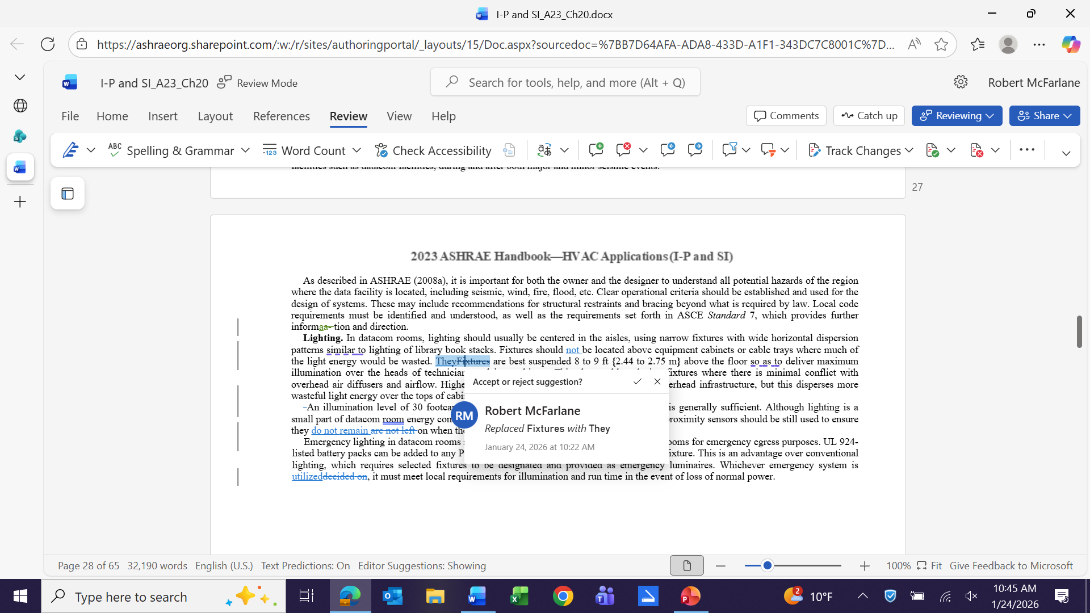
AUTHORING PORTAL
Colors Identify Change Authors
Click to See Who

Slide 42
AUTHORING PORTAL
This is the PDF Document
Your Chapter is a Word
and
PDF Document

Slide 43
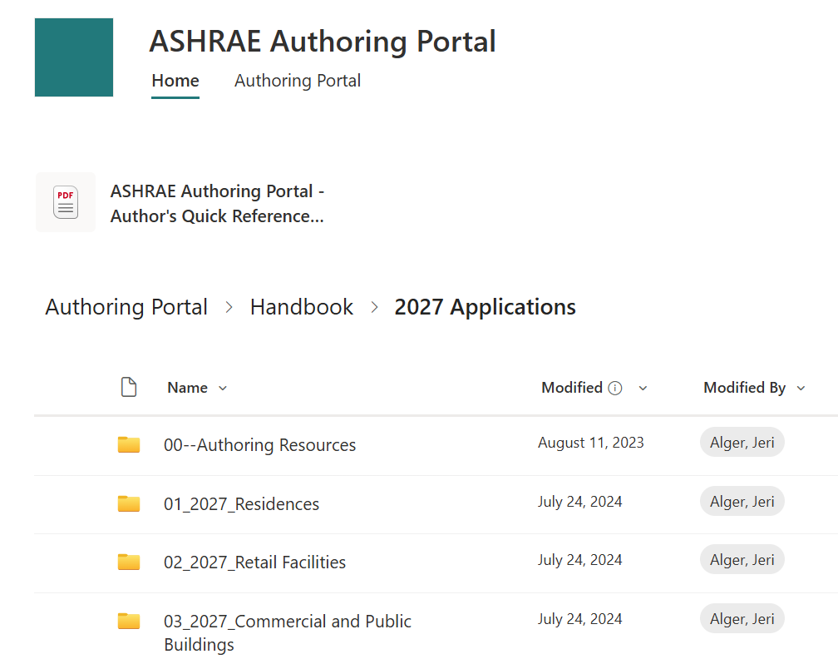
AUTHORING PORTAL
If Revising a PDF
Go To
“00-Authoring Resources”

Slide 44
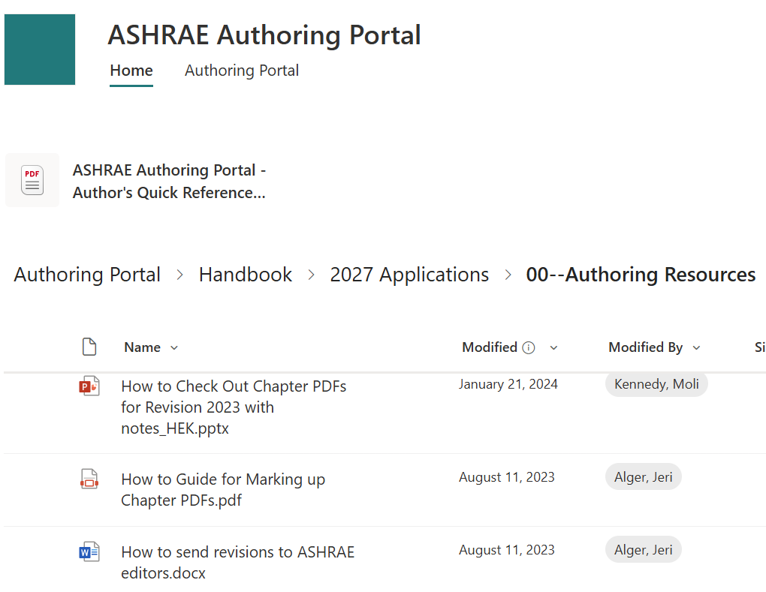
AUTHORING PORTAL
Read
“How to Guide for
Marking-up
Chapter PDF’s”
Must Use
Adobe Annotation Tool”

Slide 45
AUTHORING PORTAL
You Don’t Have a Folder for Illustrations
CLICK “SEE ALL”

Slide 46
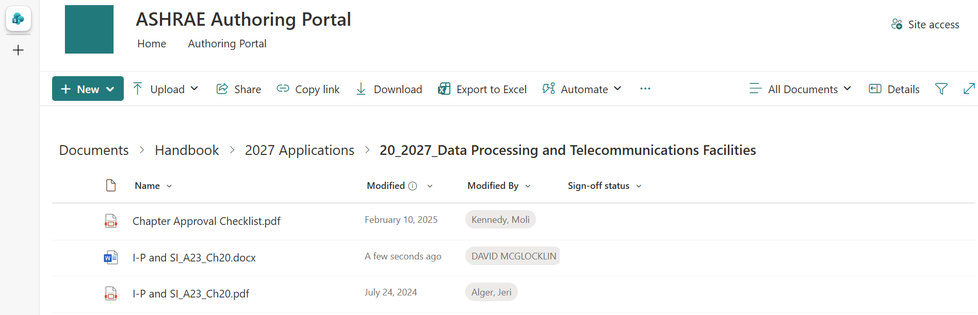
AUTHORING PORTAL
Create Folder for Charts & Illustrations
CLICK “NEW”

Slide 47
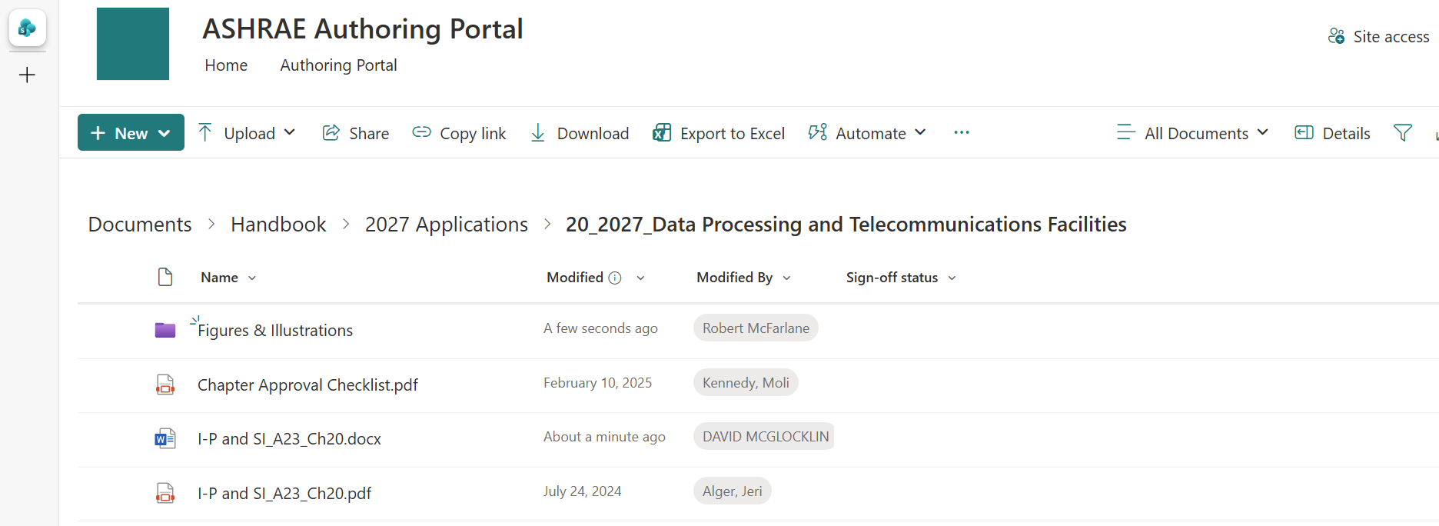
AUTHORING PORTAL
Store New and Revised Charts and Illustrations Here
Reference in Word Document

Slide 48
FIGURES & ILLUSTRATIONS
Select Colors That Reproduce in B & W
Must Have Permissions
If From ASHRAE Publication – Cite Source
If From US Gov’t. Publication – Cite Source
If From Company
Written Permission Letter
Preferably “In Perpetuity”
If Original Creation, Provide Author for Citation

Slide 49
FIGURES & ILLUSTRATIONS
Format Preferences:
1. Layered PSDs (PhotoShop Documents)
2. Flattened TIFFs
3. Flattened JPEGs.
600 DPI or Larger
(Internet Copies are NOT Usable!)
Large Tables or Examples
Upload Excel Files or Table – Note in Text
Provide Links to Docs Hosted on Websites

Slide 50
FIGURES & ILLUSTRATIONS
ANNOTATE IN TEXT !!
Insert “Comment”
Indicate “New” or “Replaced”
If Simple Revision, Explain

Slide 51
ASHRAE Handbook Training
for
TC Handbook Chapter Chairs
Moli (Heather) Kennedy
Handbook Editor
hkennedy@ashrae.org
Jeri Alger
Managing Editor
jalger@ashrae.org
And Your Liaison !!

