Slide 1
Research Subcommittee Chair’s Breakfast Meeting
Kansas City, Summer 2019
David Yashar
Vice-Chair, Research Administration Committee
David A. Yashar, PhD
National Institute of Standards and Technology
dyashar@nist.gov

Slide 2
Reviewed
5 Research Topic Acceptance Requests (RTAR)
x Accepted with comments
x Rejected
11 Work Statements
x Accepted with comments
x Rejected
XX Unsolicited Research Project
XX Funded Extension Request
XX Contractor Selections for XX Projects

Slide 3
RAC Membership for SY 19-20
Leadership
Chair: David Yashar
Vice-Chair: Chris Wilkins
RPS Chair: Curtis Eichelberger
RAS Chair: Mike Pouchak
Liaisons
Section 1: Ahmed Kashef | Section 6: Omar Abdelaziz
Section 2: William Hutzel | Section 7: William Murphy
Section 3: Steve Kujak | Section 8: Chris Seeton
Section 4: David Claridge | Section 9: Paolo Tronville
Section 5: Dennis Loveday | Section 10: Lorenzo Cremaschi

Slide 4
Awards
RAC administers five awards and grants:
Grant in Aid
New Investigator Award
Homer Addams Award
Service to ASHRAE Research
Innovative Research Grant

Slide 5
Grant In Aid
Purpose: To acknowledge graduate students researching ASHRAE related technology, and welcome them into the society
Up to $10,000 plus additional $1500 for paper presentation
Received 50 applications and selected top 19 candidates during spring meeting
2019 Recipients
Tareq Abuimara | Brent Huchuk | Gen Pei | Mengjie Tang
Yiyi Chu | Sangeetha Kumar | Pradeep Ramasubramanian | Danielle Wagner
Afshin Faramarzi | Qinbo Li | Hadi Ramin | Yunyang Ye
Kheiri Farshad | Tianyuan Li | Saad Saleem | Ioannidis Zisis
Ellyn Harges | Jonathan Ore | Jacob Tabeel

Slide 6
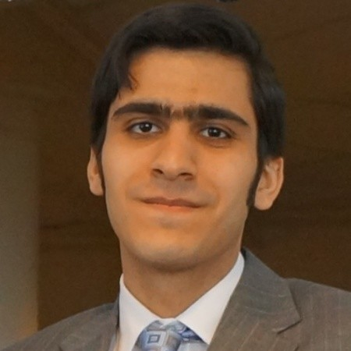
New Investigator Award
Purpose: To enhance careers of new (<5y) faculty members and promote research related to ASHRAEs goals
Highly competitive award based on teaching and research accomplishments and plans
Award up to $125k over 3 years to support research
8 applications reviewed during winter meeting
2019 New Investigator Award:
Dr. Mohammed Heidarinejad
Illinois Institute of Technology
Improving control sequences in existing buildings using virtual and physical testbeds

Slide 7
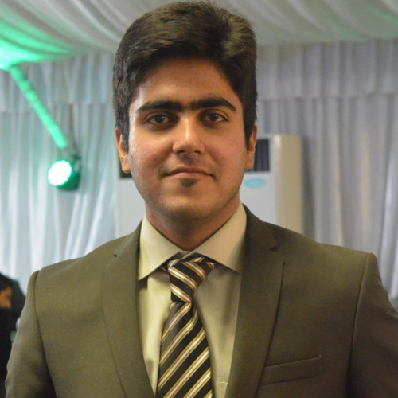
Homer Addams Award
Endowment of founder and past president of ASHVE
Purpose: To recognize a graduate student for an outstanding paper in STBE that was produced from ASHRAE sponsored research
RAC selects recipients during the winter meeting
Award of $5,000 and plaque presented at the plenary
2019 Homer Addams Award:
Omer Sarfraz
Oklahoma State University
Equipment Power Consumption and Load Factor Profiles for Buildings’ Energy Simulation
ASHRAE RP-1742: Update to Measurements of Office Equipment Heat Gain Data

Slide 8
Innovative Research Grant
To establish seed funding for novel research that does not fit within the TC structure
- Out of the box research to complement that by the TCs
Competitive 2-stage review process for $125k grant
$50k per year for 2 years, $25k matching funds for year 3
RAC reviewed 15 Stage 1 preproposals in Atlanta, invited 4 full proposals
RAC selected the top proposal on Saturday, will announce in Orlando

Slide 9
Service to ASHRAE Research
Recognizes individual for excellence in volunteer service to Society Research
Nominated by TC/TG Chairs
Key dates:
- Submission deadline is September 1, 2019
- RAC reviews and selects awardee during the Fall
- Winner announced during winter meeting

Slide 10
Training
Project Monitoring Subcommittee (PMS) Training required for all new PMS members
Last session April 25
Next session will be held in Oct/Nov – stay tuned

Slide 11
Funded Publications - Background
Research funds to support special publications that increase the effectiveness of ASHRAE research
Approximately 10% of the research budget
Design guides and manuals that support ASHRAE’s goals
Efforts considered where commercial need exists and too much effort for volunteers
May be used for new publications of updates to existing ones

Slide 12
Funded Publications - Process
RAC has funded this type of effort in the past using existing processes, but we are launching a new process to address a growing need
RAC is structured to administer projects such as this, but Publications Committee has the expertise needed to ensure value to the society
We are launching a new process better suited to this type of project

Slide 13
Publication Topic Acceptance Request (PTAR)
Similar to the RTAR for research projects, but addresses issues relevant to publication efforts
Key differences:
TC will fill out and submit PTAR form to MORTS
PTAR | RTAR
Publication Need | Research Need
Target Audience | Project Objectives
Why funded effort vs. volunteer | Approach
 | Relevance and Benefit to ASHRAE

Slide 14
PTAR Process
TC submits PTAR to MORTS
Publications Committee confirms that it will be supported by ASHRAE and that audience is appropriate
Publications committee forwards the PTAR and their conformation to RAC
Unlike the RTAR stage, we cannot skip the PTAR since it will be used to coordinate efforts between RAC and Publications Committee
PTAR reviewed by the Publications Committee to assess:
Background
Publication Need
Why this should be a paid effort

Slide 15
Work Statement for Publications (WSP)
If Publications Committee approves and RAC concurs, the TC may prepare a Work Statement for Publications (WSP)
Key difference between WSP and WS
WSPs will be reviewed by RAC to ensure that the publication project is biddable and that appropriate evaluation criteria is in place to use when comparing bids
Current status – pilot effort, may accept more this way. If interested talk to liaison
WSP | WS
Proposed Table of Contents | Scope/Technical Approach

Slide 16
ASHRAE’s Research Strategic Plan
Identifies key research needs to develop standards, guidelines, best practices, and educational material
Guides TCs while developing research projects
Used by RAC to justify using ASHRAE funds
Update Research Strategic Plan
Alignment with new ASHRAE Strategic Plan
Modern technical challenges

Slide 17
Development of the Research Strategic Plan
Research Advisory Panel (RAP) is charged with developing the RSP
10 members, including the RAC Vice-Chair
Experienced, forward-thinking leaders from industry, academia, consultants, and government
RAP members appointed for 3 year term by ASHRAE President and disbanded after completion of the RSP
Suggestions? Talk to your liaison

Slide 18
Thank You!
RAC Members
Research Subcommittee Chairs
PES and PMS members
Michael Vaughn
Steve Hammerling
Donna Daniel

