Slide 1

ASHRAE PROJECT COMMITTEE TRAINING RESPONDING TO PUBLIC REVIEW COMMENTS
Updated: May 2025

Slide 2
INTENDED AUDIENCE
The intended audience for this training presentation is members and potential members of ASHRAE Standard and Guideline Project Committees. It is not intended to go into detail on topics/tasks that are only of relevance to Project Committee chairs (such as creating online ballots, balancing committee membership, etc.). These topics are covered in depth in other training materials. Please refer to the ASHRAE PCs Toolkit for additional information.

Slide 3
PROCEDURAL REFERENCES
Procedures for ASHRAE Standards Actions (PASA)
PCs Guide to PASA
Public Review Draft Standards/Online Comment Database
Instructions for the (ASHRAE) Online Database
Refer to the PCs Toolkit webpage for the most current versions.

Slide 4
TERMS/ACRONYMS/DEFINITIONS
TERM | DEFINITION
Advisory Public Review (APR) | A draft submitted for public review that contains unusual, potentially controversial, or new elements that the project committee believes would benefit from increased public scrutiny prior to finalizing the draft for publication public review.
Independent Substantive Change (ISC) | A substantive change that is independent of any other substantive change and that does not significantly affect any other requirement in the standard or guideline.
Project Committee (PC) | A project committee (of volunteers) that serves as the consensus body for a standard, guideline, or portion thereof (i.e., addendum)
Publication Public Review (PPR) | A draft approved for public review that will proceed directly to publication if, as a consequence of the review, no substantive changes are made to the draft.
Standards Action vote | An action recommending or approving publication or publication public review of a new, revised, or reaffirmed standard, guideline, or addendum or withdrawal of a published standard, guideline, or addendum.

Slide 5
TERMS/ACRONYMS/DEFINITIONS
TERM | DEFINITION
Substantive Change | A change that involves an important (has value, weight or consequence), fundamental (is the foundation, without which it would collapse), or essential (belongs to the very nature of a thing) part or changes the meaning of the material or that directly and materially affects the use of the Standard. Changes that may be found substantive when examined in context. “shall” to “should” or “should” to “shall” Addition, deletion, or revision of mandatory requirements, regardless of the number of changes Addition of mandatory compliance with referenced standards Changes or deletions made to portions of a draft not intended as part of the approved standard or guideline (e.g., a foreword, informative appendix, informative note) are not considered substantive.
Unresolved Public Review Commenter | An individual who, during the comment period, submitted public review comments to a proposed or revised draft standard, guideline. or portion thereof, was not satisfied with the committee response to those comments, and within the time period and procedure specified in the response, requested to remain “unresolved”.

Slide 6
PUBLIC REVIEW OF STANDARDS AND GUIDELINES
The ASHRAE public review process is designed to allow anyone to comment on a standard, guideline, or addendum that is being proposed, revised, reaffirmed, or withdrawn.
Public review periods are typically 30 days (for drafts no more than five pages in length) or 45 days (for drafts longer than five pages)
Announcements of public review drafts open for comment can be found in ASHRAE’s Standards Actions newsletter, which is published every Friday.

Slide 7
TYPES OF PUBLIC REVIEW
Advisory Public Review (APR) | Publication Public Review (PPR)
A project committee (PC) may approve a draft standard, guideline, or portion thereof for an APR in order to get increased public participation early in the development process to attempt to address potential controversy prior to seeking publication approval. Any comments received on an APR draft are automatically considered to be “supportive”, and PCs are not required to attempt to resolve these commenters. An APR must always be followed by a Publication Public Review (PPR). | A PC may approve a PPR draft of a standard, guideline, or addendum that they believe is ready to publish as drafted. If there are no negative votes within the PC, or unresolved commenters after the public review period, the draft may be approved for publication by ASHRAE staff. PCs are required to attempt to resolve all “substantive” comments received during a PPR, unless the PC approves a revised draft for another full publication public review.
Note: Votes to approve APRs are not considered Standards Actions motions, and do not require continuation ballots, recirculation ballots, or responses to negative votes.

Slide 8
ACCESSING PUBLIC REVIEW COMMENTS
Comments submitted on a public review draft can be viewed or downloaded from the Online Comment Database by hovering over the “Online Comment Database” tab and selecting either “My Committee Comments” or “Committee Comment Reports”.

Slide 9
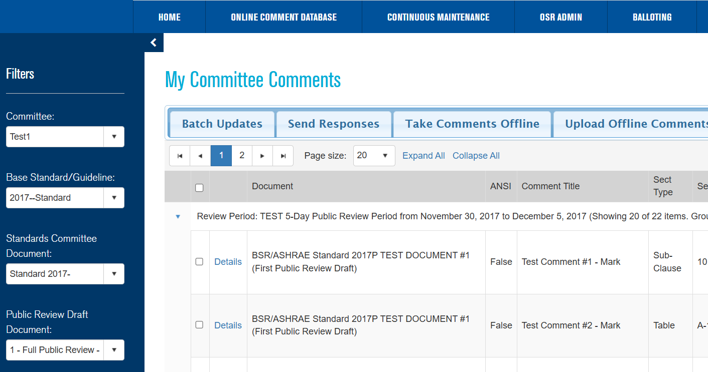
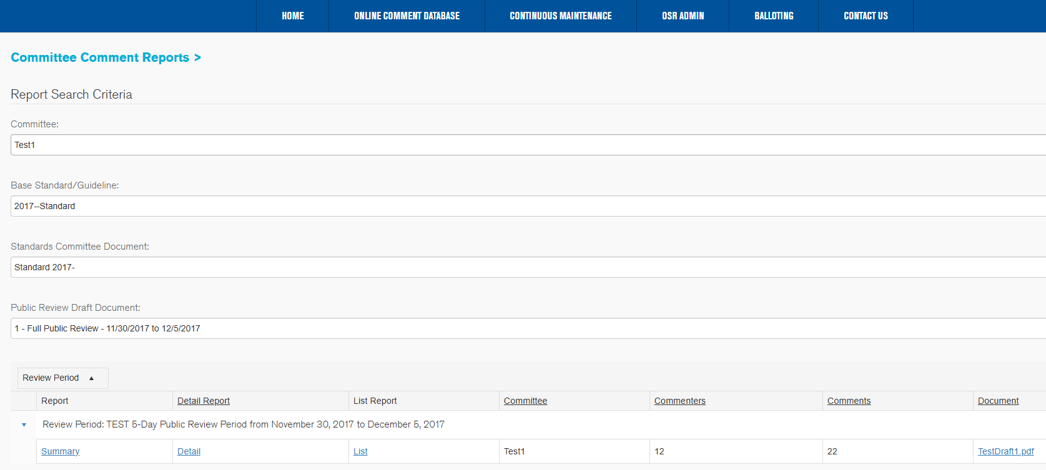
ACCESSING PUBLIC REVIEW COMMENTS
Comments can be filtered by project committee, base document, addendum, and specific public review (1st, 2nd, 3rd, etc.). Please note that a downloaded comment report will not include any attachments that may have been submitted along with a comment.

Slide 10
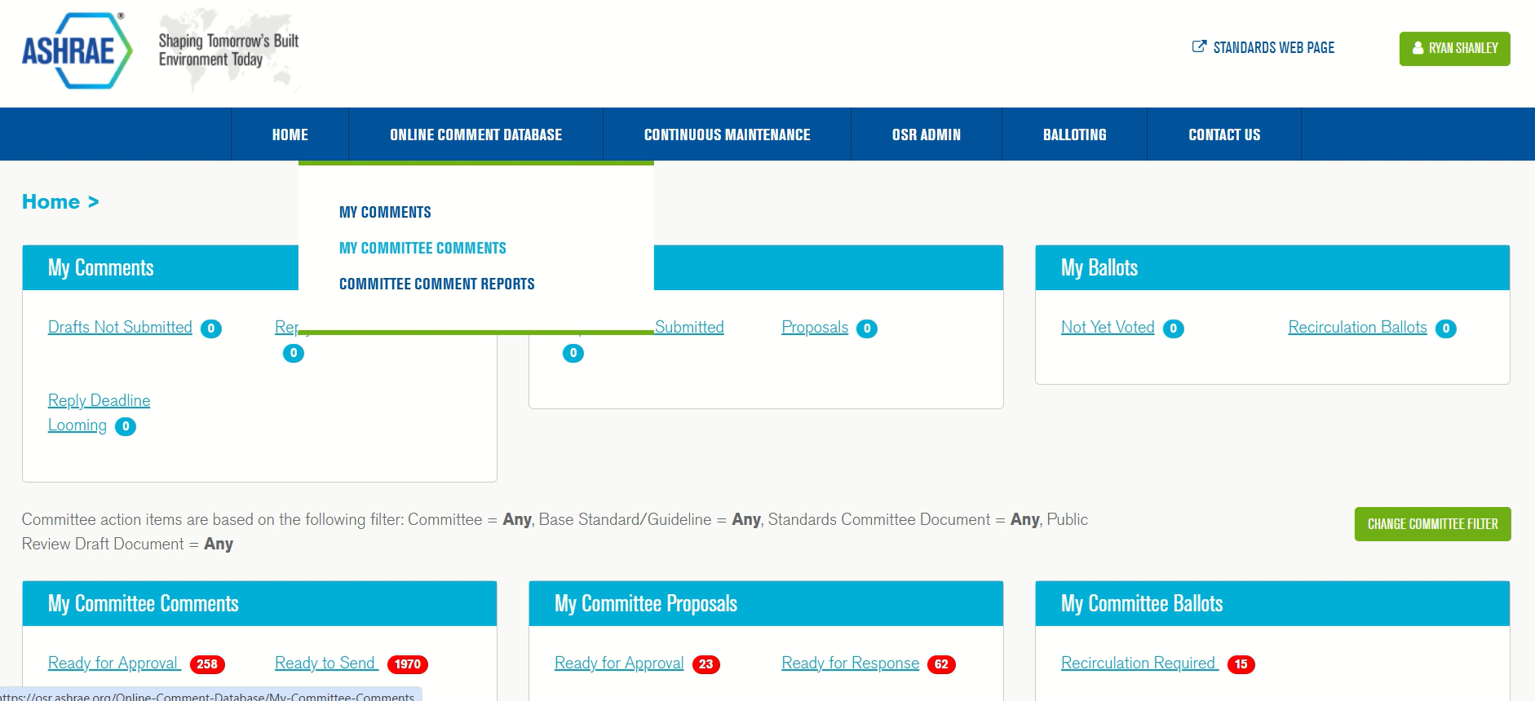
ACCESSING PUBLIC REVIEW COMMENTS

Slide 11
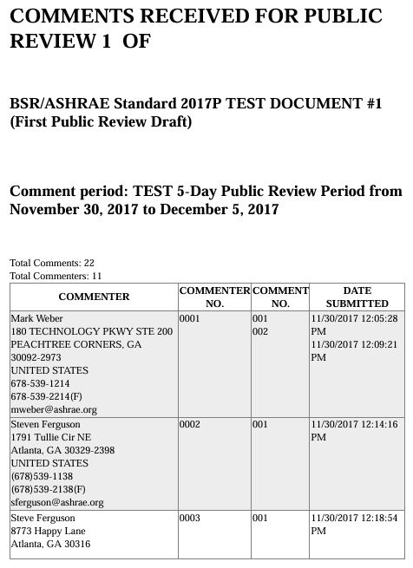
COMMITTEE COMMENT REPORT (SUMMARY)

Slide 12
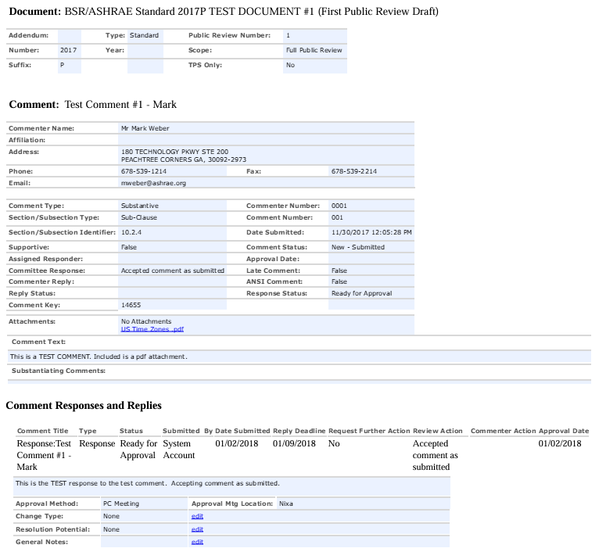
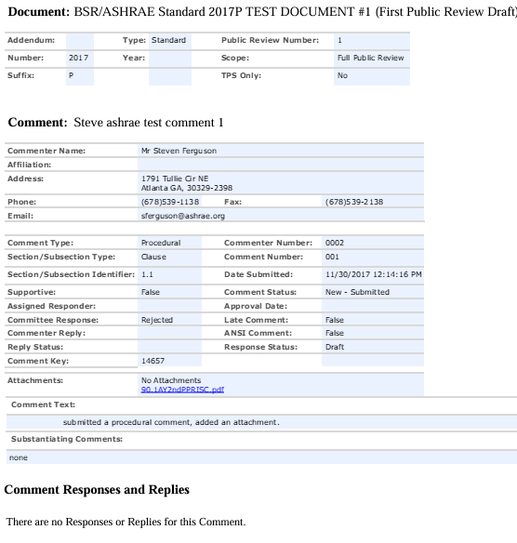
COMMITTEE COMMENT REPORT (DETAIL)

Slide 13
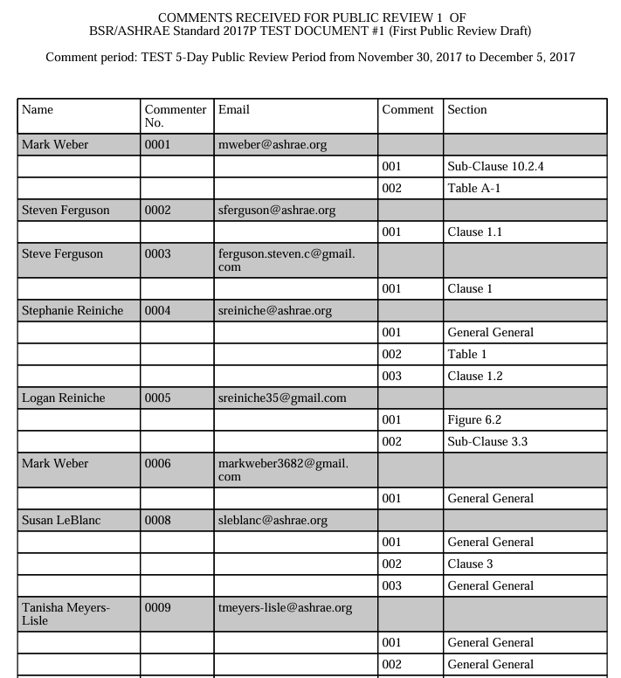
COMMITTEE COMMENT REPORT (LIST)

Slide 14
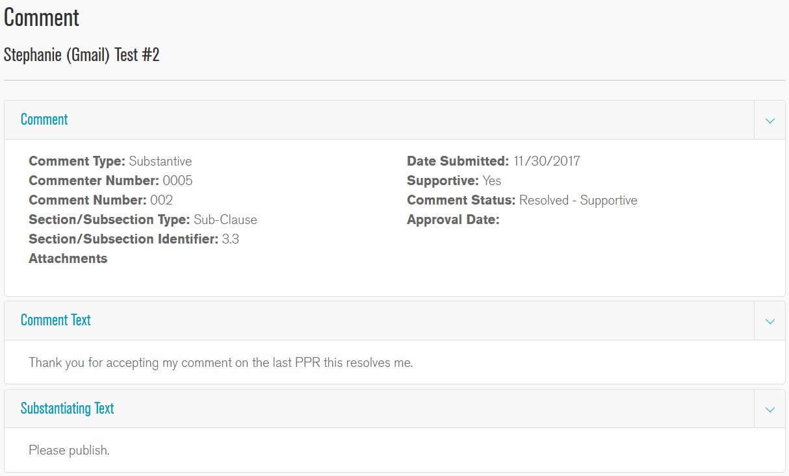
EXAMPLE COMMENT

Slide 15
CONSIDERATION OF PUBLIC REVIEW COMMENTS
All comments to public review drafts (and responses to commenters) shall be submitted electronically via the online comment database (OSR) (https://osr.ashrae.org). Comments shall be reported to all members of the PC.
Project committees must respond in writing (through the OSR) to all substantive public comments, and a “good faith attempt” must be made to resolve negative comments received. Simply responding that the committee did not agree with a comment is not a sufficient response and could be grounds for an appeal of the document’s publication.
Unless the PC is responding to a comment that it is “accepted as submitted”, detailed reasons for the committee’s response must be included.

Slide 16
NOTES ON COMMENT RESPONSES
Project committee votes to approve responses to public review comments are NOT considered Standards Action motions and may be approved by a simple majority of voting members in attendance at a committee meeting; a continuation ballot to voting members not attending the meeting is not required.
It is understood that it will not always be possible to resolve all comments, but it is required that the committee make a “good faith” effort to resolve objections. It is critical to document all efforts to resolve negative commenters in writing, whether via the OSR or through other mechanisms (such as email correspondence or meeting minutes where a commenter was invited to address the committee).

Slide 17
COMMENT RESPONSE OPTIONS
Accept comment as submitted
Accepted, with minor changes (same approach to issue but exact wording may be different)
Accepted, in principle (it is agreed that a change is required but the committee has chosen a different approach to the issue)
Rejected, except as noted (majority of the comment is not accepted)
Rejected (comment rejected in its entirety)
More information is needed
Deferred, Out-of-Scope (typical for independent substantive change drafts where only certain portions of the document are open for comment)
Deferred, Late (comment received after the close of public comment period)

Slide 18
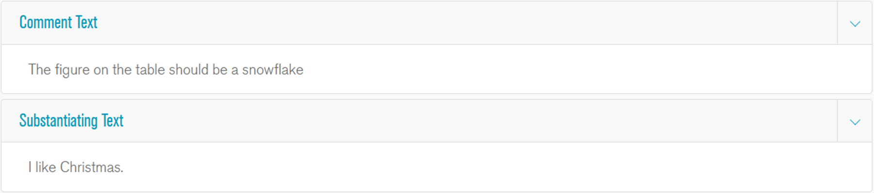
EXAMPLE COMMENT RESPONSE #1
Scenario: A commenter submits a comment that only asks that the committee change the draft but does not provide proposed changes to resolve their objection. The PC is still required to respond and to attempt to resolve the commenter’s objection.
Example Response: Thank you for your comment. The committee notes that you did not include a proposed change in strikethrough and underline form. The committee reviewed the issue and does not agree with your comment because…(insert reason here)

Slide 19
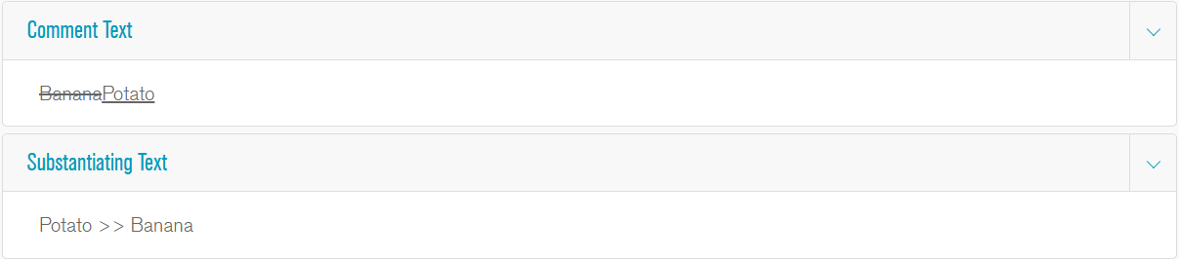
EXAMPLE COMMENT RESPONSE #2
Scenario: The commenter includes proposed changes in tracked changes. The PC does not agree with the proposed change, and does not intend to revise the referenced section in response.
Example Response: Thank you for your comment. The committee feels that the language as drafted appropriately addresses the intent of this section, and does not agree with your proposed change because…(insert reason here)

Slide 20
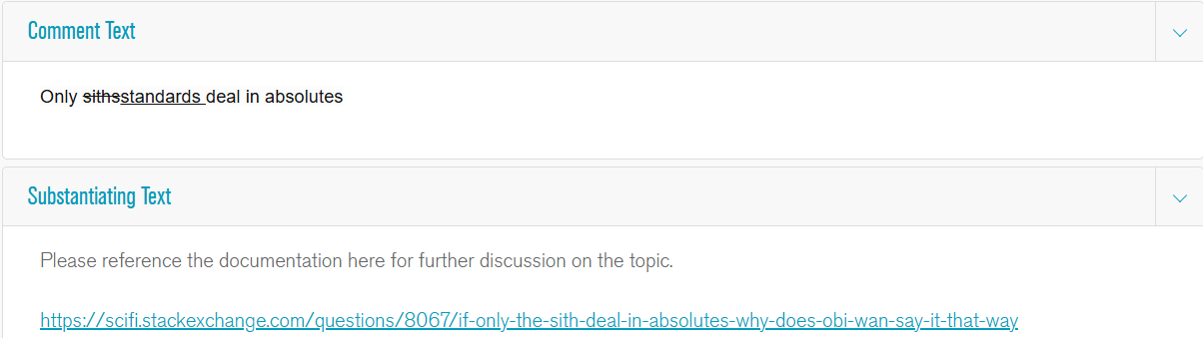
EXAMPLE COMMENT RESPONSE #3
Scenario: The commenter includes proposed changes in tracked changes. The PC does not agree with the proposed change, and is proposed a different change to the section referenced in the comment.
Example Response: Thank you for your comment. The committee received several comments on this section and intends to the following revisions for the next public review draft: (insert revised text here). The committee did not agree with your proposed change because …(insert reason here)

Slide 21
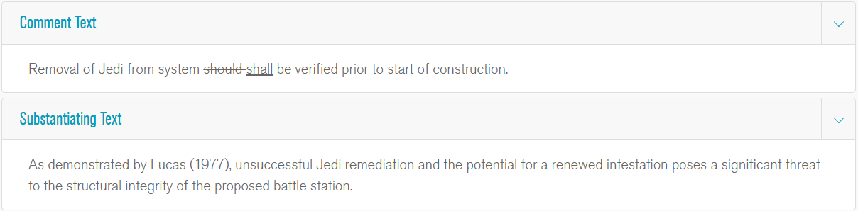
EXAMPLE COMMENT RESPONSE #4
Scenario: A commenter submits a proposed change in tracked changes. The PC agrees to the change.
Example Response: Thank you for your comment. The committee agrees with your proposal and intends to include this change in the next public review draft.

Slide 22
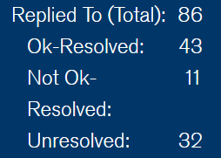
REPLIES FROM COMMENTERS
After the PC has responded to the comments, commenters have an opportunity to reply to the PC to indicate if the response has resolved their objection, or if they remain unresolved.
There are three options for commenter reply: “Ok-Resolved”, “Not Ok-Resolved”, and “Unresolved”. “Not Ok-Resolved” indicates that the commenter does not agree with the committee’s response, but does not wish to delay publication of the document.
Any unresolved commenters remaining when the document is approved for publication will be granted a right to appeal; this is why it is critical to document all attempts to resolve commenters to be able to demonstrate that ASHRAE’s process has not been violated.

Slide 23
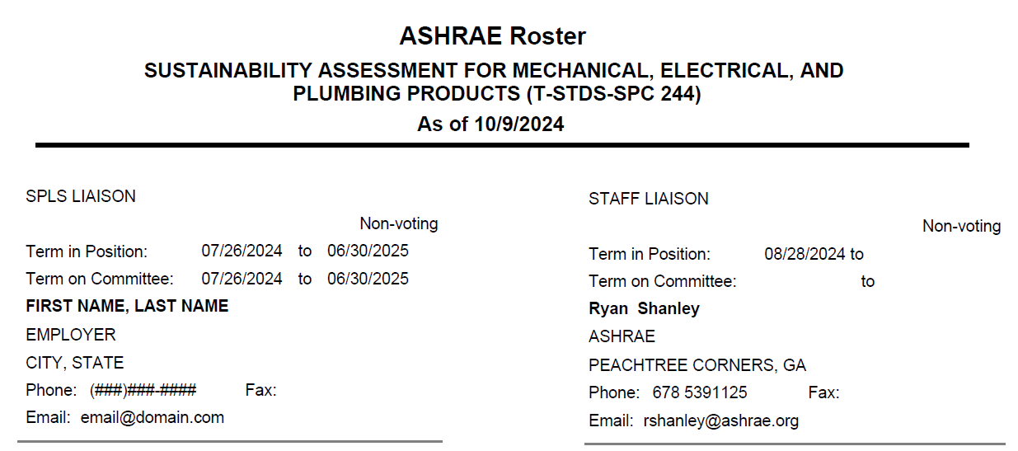
QUESTIONS/ASSISTANCE
Every ASHRAE project committee is assigned both an SPLS liaison and an ASHRAE staff liaison, either of whom is an invaluable resource for guiding/assisting the PC’s work.
The names of the committee’s assigned SPLS and staff liaisons can be found at the very end of the committee membership roster.

Slide 24
STANDARDS SECTION STAFF
Direct Phone Line: (678) 539-XXXX (Ext.)
Staff Member | Email Address | Ext.
Standards Committee Ryan Shanley, Senior Manager of Standards | rshanley@ashrae.org | 1125
Procedures, PPIS, Appeals Tanisha Meyers-Lisle, Asst. Manager of Standards - Administration | tmlisle@ashrae.org | 1111
SPLS, SRS Carl Jordan, Standards Administration Specialist | cjordan@ashrae.org | 1175
General Inquiries/Assistance Standards Section | standards.section@ashrae.org

