Slide 1
ASHRAE Tools for TCs
Module developed by
Cynthia Gage
Technical Activities Committee

Slide 2
Outline
Master Calendar
E-mail aliases
On-line Forms
For meeting operations
Other
Training
Other support
Conference calls and web meetings
Collaboration tools – in testing by ECC

Slide 3
Master Calendar
Shows all due dates for the society year
Updated shortly after the summer meeting

Slide 4
E-mail alias
Simplifies contacting procedures
YOUR alias is TCxxyy@ashrae.net
Where xx is two-digit section number (e.g. 08)
Where yy is two digit TC number (e.g. 01)
Position Alias is attached to primary e-mail address in ASHRAE Bio
Similarly
Section Head – SHx@ASHRAE.net
RAC liaison – RLx@ASHRAE.net
Where x is Section number (e.g. 8)
Alias list also has names of present position holder
ASHRAE staff also have aliases.

Slide 5
TC Operation Forms
TC Meeting Request Form
ASHRAE staff prefers to have forms
Default: same MAIN meeting time and space requirements
If changes are needed, forms due 3 months prior to meeting
Subcommittee meetings must be requested at each meeting
Due dates for forms are on Master Calendar
Routine Forms
Activity Form (fillable in Excel)
Due to Section Head by 9:00 pm Tuesday of Conference
Meeting Sign-in Sheet (example)
Minutes Cover Sheet (fillable in Word)
Attach to minutes when submitting to ASHRAE

Slide 6
Other Forms
Emergency Roster Change
To fill a leadership vacancy
To add a voting member in order to achieve minimum membership
Hightower Award
Excellence in technical leadership and contributions in last four years
Due Sept 1
Research Forms – access thru Research Webpage
RTAR (fillable in Word, including coversheet)
Work Statement Coversheet

Slide 7
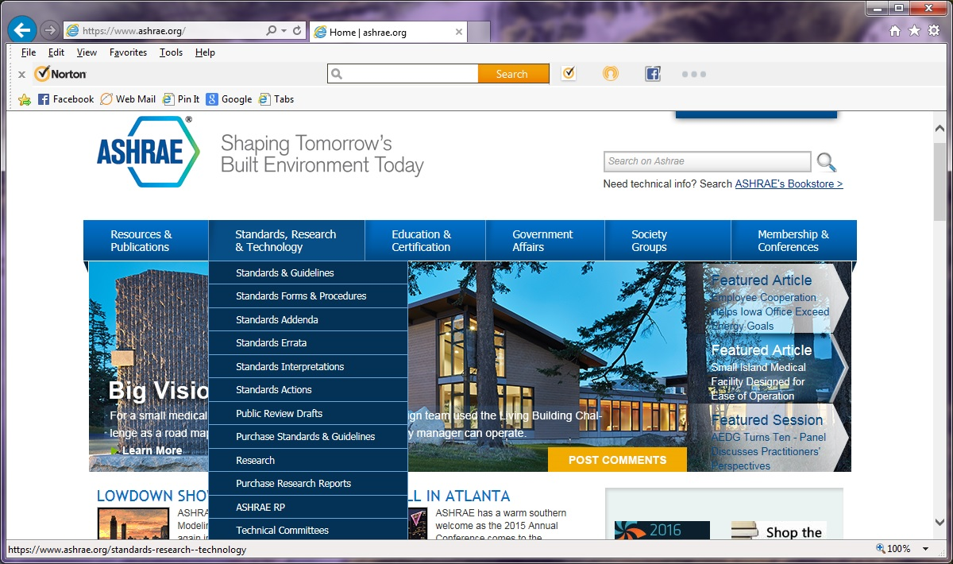
Locating Technical Committees

Slide 8
Fourth Heading on TC Webpage

Slide 9
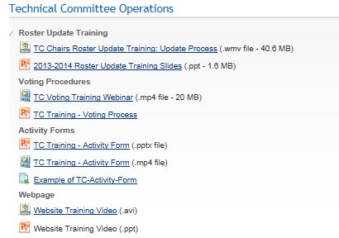
Training – Link at Third Heading

Slide 10
Training – con’t

Slide 11
Other Support
Conference calls and web meetings
Remote participation for TC meeting at conference
Meetings between conferences
Interested? Info request found on main TC webpage
Collaboration tools
ASHRAExchange
Forum discussions
ECC evaluating Basecamp
TC-specific discussions
Sharing documents in development

Slide 12
Upcoming
NEW TC webpage format (in development)
Reduce webmaster’s work load
Eliminate html
Auto-loading of info ASHRAE HQ has (i.e. TC membership)
Includes a mobile-friendly format
Hosted on ASHRAE server
Initial roll-out ≈ Fall
Additional features anticipated
Auto-loading of other HQ information

Slide 13
TACcoord1@ashrae.net

