Slide 1
TC/TG/TRG/MTG
Chair & Vice Chair
Training Workshop
Cynthia Gage
Training Coordinator
Technical Activities Committee
TACcoord1@ashrae.net

Slide 2
Training Overview
Section Heads
On the Horizon
Roster Updates
  Information Sources

Slide 3
Section Heads
Are your liaison to the Technical Activities Committee
Represent the interest of the Sections and makes sure their views and concerns are known.
  Share your issues at the Section Breakfast, on your activity form (due Tuesday at 9:00pm), or through other contact
Advise the Chair on operating policies and procedures
  Review websites
Are ex-officio members of your committees
  Be sure they receive the minutes and coversheet of your meetings
  Use the e-mail alias: SH#@ashrae.net

Slide 4
Committee Operations Requiring Section Head Approval
Emergency Roster change
Extension of Chair beyond two consecutive one-year terms
Extension of voting members beyond four consecutive one-year terms
Subcommittees formed for special publications
Cancellation of TC/TG/MTG meeting at Society meeting
  Substitution with meeting outside of Society meetings
Selection of Chair, Vice-Chair, and members at time of Roster submission

Slide 5
On the Horizon
Presentation for Chapters
  What are TC/TG/TRGs and how to get involved
New activity form and format
  Excel spreadsheet
  Additional queries
    YEA participants, program submissions, awards

Slide 6
Roster Update Process
Brian Fricke
Roster Coordinator
Technical Activities Committee

Slide 7
Roster Updates
Roster updated annually
  Leadership changes
  VM to CM rollover (4 year term)
  Members leave/join committee
Responsibility of TC/TC/MTG Chair
  Consult with TC Vice Chair, Section Head
  TC Membership Subcommittee Chair assists
  Balance desired, but not required
  Strive for uniform rollover rates
  Start early!

Slide 8

Roster Timeline
Winter Meeting Due Tuesday 9 pm | Completed Rollover Roster Workbooks submitted to Section Heads TC Chair completes workbook Signs/submits to Section Head (e.g., sh5@ashrae.net). Electronic version preferred.
February | Section Head reviews workbook Changes resolved with TC Chair during February Submits approved workbook to HQ staff
 | HQ staff generates draft roster from workbook (PDF format) Section Head reviews draft roster Iterative process Roster changes after this time only made if emergency Emergency = no quorum, employer duplication, error
May | HQ staff makes final roster available to members Distribution through Section Heads NOT for public dissemination
July 1 | New Rosters effective
November | Rollover Roster Workbooks distributed to TC Chairs Workbook provided by HQ staff Excel spreadsheet with instructions

Slide 9
Update Process Responsibilities
Process involves:
  TC, with Chair being principal
  Section Head
  HQ staff
Everyone must do their part and in a timely manner or else process fails
If process fails TC may be unable to conduct business

Slide 10
4
Rollover Roster Workbooks
TC/TG
3
5
2
1

Slide 11
Membership List and Status
- ONLY add code (AV, AC, DV, D, NC)
- Do not change member information or positions in this section.
- Add notes in adjacent column
- Add additional member names, ASHRAE Numbers, and Status at the bottom of the list.
- New position added, Provisional Corresponding Members.
Membership List and Status Add additional member names, ASHRAE Numbers, and Status at the bottom of the list.
 |  | T-TAC-TC02.01
Member # | Name | Employer | Appointed Year | End Year | Position | Status Code (Required)
2051047 | Mr Mark C Jackson | Lennox Industries Inc | 07/01/2010 | 06/30/2011 | Vice Chair
7964757 | Dr John L Stoops | KEMA | 07/01/2010 | 06/30/2013 | Secretary
2053704 | Prof Chandra Sekhar, PhD | National University of Singapore | 07/01/2010 | 06/30/2014 | Research Subcommittee Chair
105030 | Mr James J Bushnell | Hvac Consulting Services | 07/01/2009 | 06/30/2013 | Program Subcommittee Chair
5118611 | Mrs Diotima A Von Kempski | Dvk Air Vitalizing System | 07/01/2008 | 06/30/2012 | MEMBER NON QUORUM
5053606 | Dr Arsen K Melikov, PhD | Technical Univ Of Denmark | 07/01/2007 | 06/30/2011 | MEMBER NON QUORUM
22856 | Dr Edward A Arens | University Of California | 07/01/2009 | 06/30/2013 | Member

Slide 12
Provisional Corresponding Member – Added by Staff

Slide 13
Membership Notes
Provisional Members act as Corresponding members, but only serve 2 year terms.
  This position was added in order to allow ASHRAE staff to add members to the committee throughout the society year. During the time, review the list of Provisional members and decide to add them as corresponding members or delete them from your current roster. If there are no changes, after 2 years, they will drop from the roster.
No two people may serve as Voting Members if both individuals have the same employer. One of the individuals should serve as a Corresponding Member.
Voting members should have previously been corresponding members.
Term limits: Voting = 4 years; Voting Non Quorum Members = 4 years; Corresponding = Unlimited.

Slide 14
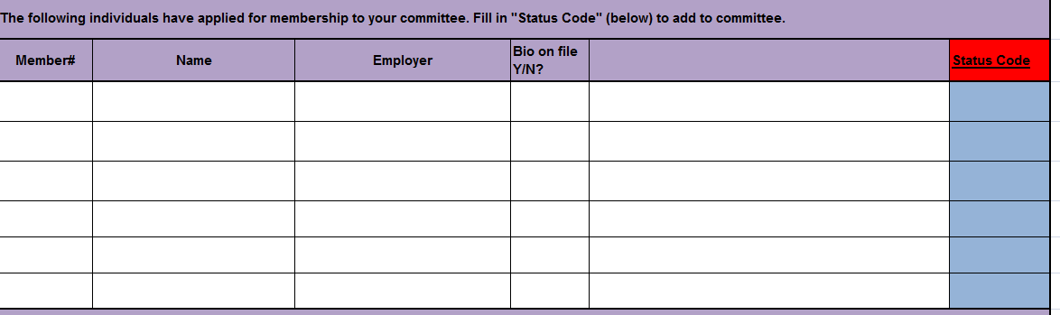
2. New Members
- Biographical info
- Must have ASHRAE number or contact info
MENTORING OF NEW MEMBERS ENCOURAGED!!

Slide 15
3. Management Team
- Get needed info from membership list

Slide 16
Management Team Notes
Term limits:
  Chair = 2 years with a 1 year extension through the approval of the Section Head;
  Vice Chair = 2 years;
  The Chair's voting term is not limited by the policy limiting normal Member and Voting member Non Quorum reappointments to four (4) consecutive terms.
Chair and Vice Chair MUST BE ASHRAE members!
The Chair should have served at least one one-year term as Vice Chair or Secretary.
Corresponding Members can serve in all TC management positions except Chair.

Slide 17
4. Approval Section

Slide 18
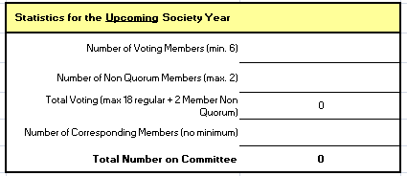

Slide 19
ROSTER UPDATE - MTG
 |  | Multidisciplinary Task Group Committee Management Team
 |  | 2012/2013 Committee Appointments T-TAC-MTG.BIM
PROPOSED | Position | ASHRAE ID Number | Name |  |  | Continuing from Current Year? (Y/N)
 | Chair (Not required to be ASHRAE member, but preferred)
 | Vice Chair (Not required to be ASHRAE member, but preferred)
Additional Placement
 | Subcommittee or Position | ASHRAE ID Number | TC or non-TC group Affliation | Name |  | Continuing from Current Year? (Y/N)
Additional Position or Sub Committee Chair
Additional Position or Sub Committee Chair
Additional Position or Sub Committee Chair
Not required to be ASHRAE member, but preferred
Affiliation or Group being represented – NOT employer

Slide 20
Legend for Status Code
Add Voting | AV
Add as Alternate | AA
Delete Voting (Will be moved to Alternate) | DV
Delete (Will be deleted from the roster) | D
No Change | NC
Roster Update - MTG
 |  | T-TAC-MTG.BIM
ASHRAE ID Number | Name | TC or non-TC group Affliation, if applicable | Appointed Year | Position |  | Status Code (Required)
397966 | Mr Malcolm D Knight, PE |  | 07/01/2011 | 06/30/2012 | Vice Chair
2012220 | Mr Charles S Barnaby | MEMBER-TC 4.07 | 07/01/2011 | 06/30/2012 | Member
154864 | Dr Drury B Crawley, PhD | MEMBER-TC 4.02 | 07/01/2011 | 06/30/2012 | Member
2053287 | Mr Charles E Gulledge, III | MEMBER- TC 7.01 | 07/01/2011 | 06/30/2012 | Member
5206098 | Dr Robert J Hitchcock | MEMBER- SGPC20, SPC205P | 07/01/2011 | 06/30/2012 | Member
8087267 | Mr James F Pegues | MEMBER- TC 4.01 | 07/01/2011 | 06/30/2012 | Member
5011825 | Mr Steven L Rosen | MEMBER-TC 1.05 | 07/01/2011 | 06/30/2012 | Member
630787 | Mr Ronald E Wood, PE | MEMBER- GSA | 07/01/2011 | 06/30/2012 | Member
5141592 | Mr Christopher K Wilkins, PE |  | 07/01/2011 | 06/30/2012 | Chair
3030489 | Mr Markku Allison |  | 07/01/2011 |  | Alternate
8172321 | Mr David R Conover | ALTERNATE - PAST CHAIR | 07/01/2011 |  | Alternate
144531 | Mr John Crosby | ALTERNATE - #1, TC 1.05 | 07/01/2011 |  | Alternate
8071997 | Dr Hywel Davies, PhD |  | 07/01/2011 |  | Alternate
8074826 | Mr Brian C Emtman |  | 07/01/2011 |  | Alternate
Affiliation or Group being
represented – NOT employer
Make changes to
this column ONLY
1 Year term but
renewable indefinitely
Note: Voting alternate
and priority for TC 1.05

Slide 21
Roster Update Workbook Key Elements
Membership List and Status
  ONLY add code (AV, AC, DV, D, NC)
  Add notes in adjacent column
New Members
  Biographical info
  Must have ASHRAE number or contact info
Management Team
  Get needed info from membership list
Approval Section

Slide 22
Questions?

Slide 23
Information Sources for the
TC Chair and Vice Chair

Slide 24
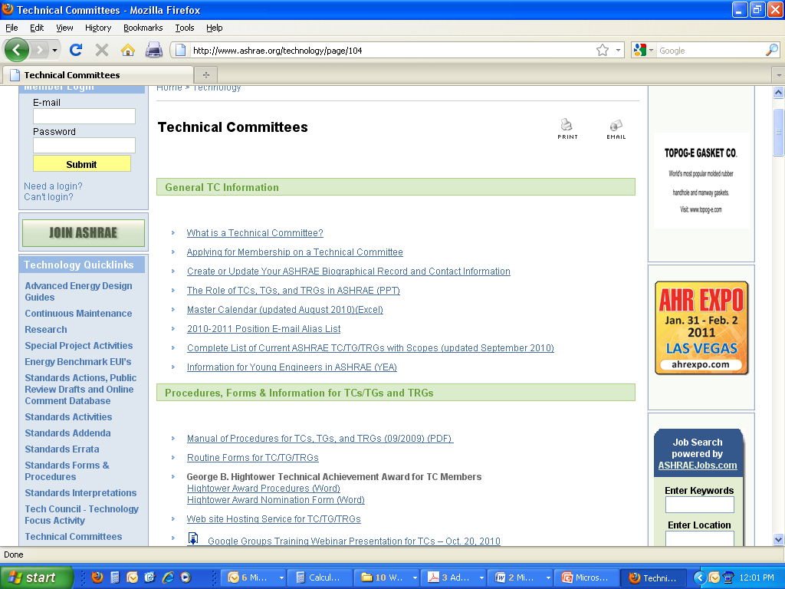
ASHRAE Website
http://www.ashrae.org/standards-research-technology/technical-committees

Slide 25
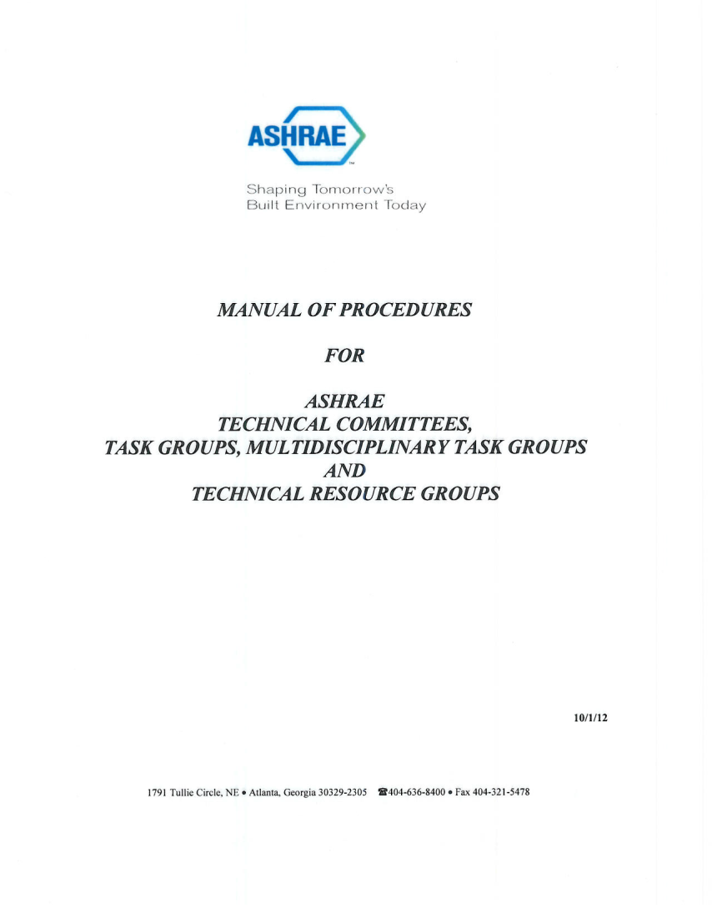
TC Home Page Links - Examples
Presentation on “The Role of TCs, TGs, and TRGs in ASHRAE”
Past TC Training Workshop presentations
Info on TC Subcommittee meetings via conference call
Other document links

Slide 26
Master Calendar
Activity | Point of Contact or Responsible Person | 2010 |  |  |  |  |  | 2011
 |  | July | Aug. | Sept. | Oct. | Nov. | Dec. | Jan. | Feb. | March | April | May | June
TC/TG (Tasks)
Planning for 2010-2011 Society Year TC/TG/TRG Membership | TC/TG/TRG Chair works with Section Head (SH#@ashrae.net) |  |  |  |  |  | 11/30 TC/TG/TRG Chair receives workbook from HQ staff | 1/26 Chair submits workbook to Section Head by 9 pm | 2/28 final approval of roster workbook by Section Head |  |  | Roster distributed to TC/TG/TRG Chair
Distribute Pre-Meeting Reminders | TC/TG/TRG Vice Chair to entire TC/TG/TRG |  |  |  |  |  | 12/20 | Las Vegas, NV |  |  |  | 5/22 | Montreal
Request Subcommittee Meeting Space | Subcommittee Chairs to TC/TG/TRG Chair |  |  |  | 10/7 |  |  |  |  | 3/9
Request for meeting rooms, times, & equipment for next meeting. | TC/TG/TRG Chair to J. Marshall (HQ) (jmarshall@ashrae.org) |  |  |  | 10/21 |  |  |  |  | 3/23
Distribute Meeting Agenda | TC/TG/TRG Chair to entire TC/TG/TRG |  |  |  |  |  | 12/20 |  |  |  |  | 5/22
Submit PDC Liaison Activities Report | TC/TG PDC Liaison to TC/TG Chair and PDC Chair |  |  |  |  |  | 12/20 |  |  |  |  | 5/22
Re-Affirm need for TAC Intersociety Liaisons assigned to TC/TG and have liaison submit status report on Intersociety Liaison activities | TC/TG Chairs Notify Section Heads as to need and each Inter-Society Liaison submits report to TAC Liaison Coordinator (TACliacoord@ashrae.net) |  |  |  |  |  |  |  |  |  |  | 5/22
Submit TC/TG/TRG Objectives | TC/TG/TRG Vice Chair to Section Head |  |  |  |  |  |  |  |  |  |  |  | 6/24
Submit TC/TG/TRG Activity Sheet | TC/TG/TRG Vice Chair to Section Head |  |  |  |  |  |  | 1/22 |  |  |  |  | 6/24
Annual request for TC/TG/TRG Continuation | TG/TRG Chair to Section Head |  |  |  |  |  |  |  |  |  |  |  | 6/24
Distribute List of Action Items | TC/TG/TRG Chair to TC/TG/TRG | 7/10 |  |  |  |  |  |  | 2/5
Distribute Minutes | TC/TG/TRG Chair to entire TC/TG/TRG |  | 8/25 |  |  |  |  |  |  | 3/22
George B. Hightower Award Nominations | TG/TRG Chair to Section Head |  |  | 9/1
Requests for "Thank You" Letters to Employers | Use following link: www.ashrae.org/thankyouletter | No later than July 3 to HQ |  |  |  |  |  |  |  |  |  |  | No later than July 15 to HQ
Handbook
2010 Refrigeration | M. Owen, Handbook (HandbookEditor@ashrae.net) | Print/CD published June 1, 2010. TCs/TGs should review 2010 chapters and plan for 2014 edition or earlier updates for Handbook ONLINE.
2011 HVAC Applications | M. Owen, Handbook Editor | TC/TGs should be submitting final revisions to liaisons or voting on approval in Albuquerque. All chapters must be in by July 31, 2010.
2012 HVAC Sys & Equip | M. Owen, Handbook Editor | TC/TG should be revising chapters for final approval in Jan. or June 2011.
2013 Fundamentals | M. Owen, Handbook Editor | TC/TGs should have completed review of 2009 chapters and selected revisers for 2013 edition. Specific areas for improvement should be identified and revisions begun.
Program

Slide 27
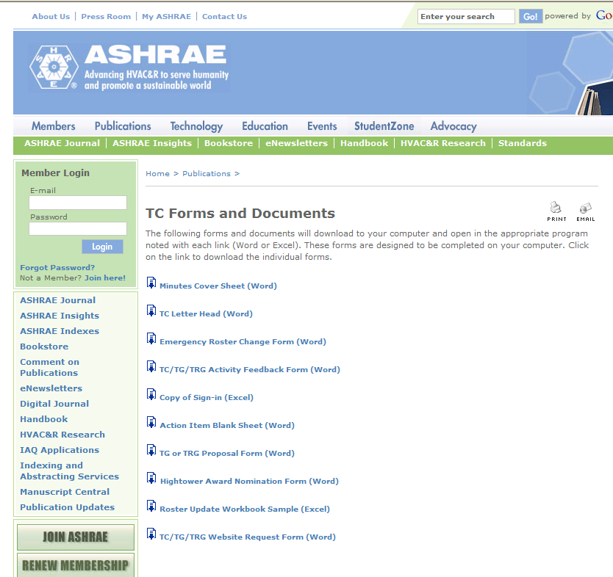
TC/TG/TRG Forms

Slide 28
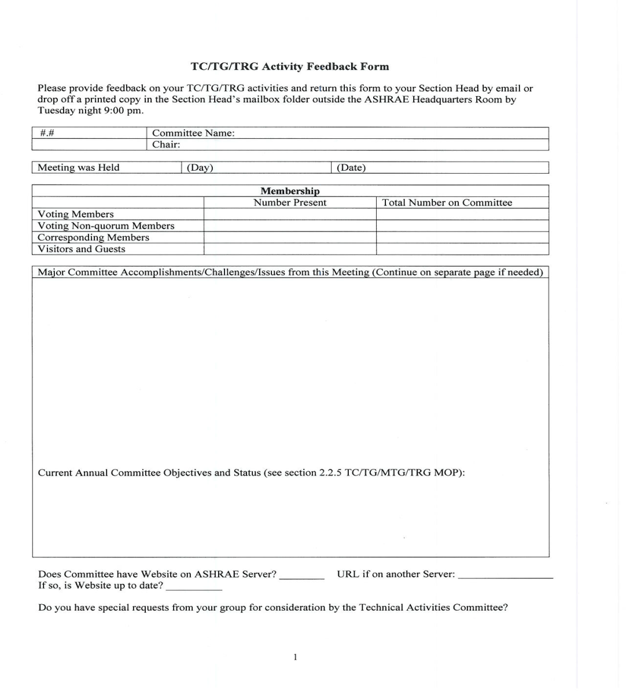
Activity Form
https://www.ashrae.org/standards-research--technology/technical-committees/tc-forms-and-documents
Notes:
Can download form from website or pick up copy at the HQ office

Slide 29
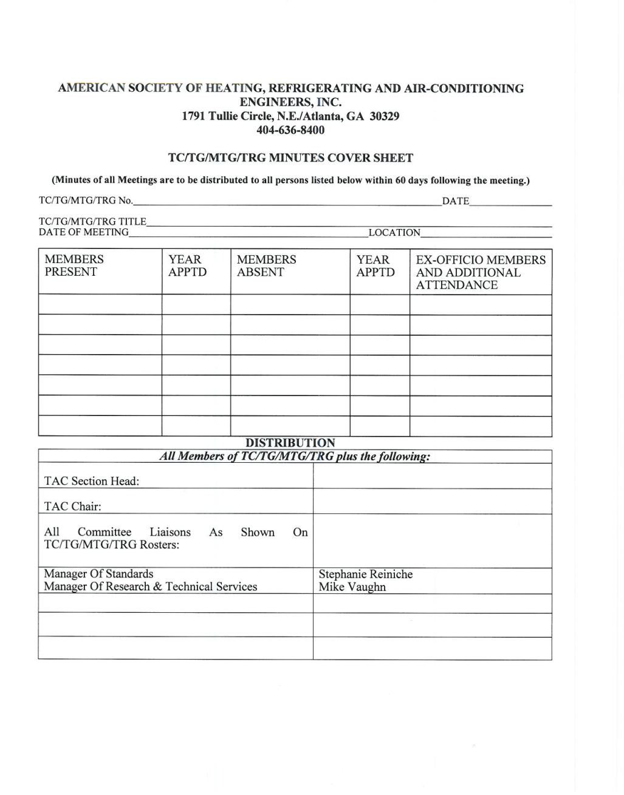
Minutes Coversheet
https://www.ashrae.org/standards-research--technology/technical-committees/tc-forms-and-documents

Slide 30
When all else fails:
Ask your Section Head
SH#@ashrae.net
Ask your Liaisons
RL#@ashrae.net

Slide 31
THANK YOU !
ASHRAE could not exist
without your leadership
of technical activities
throughout the year

